Slide 1


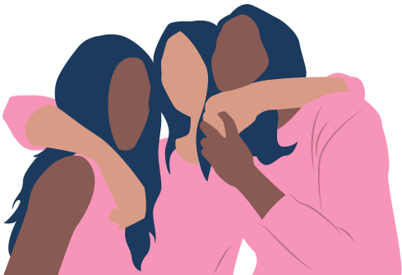

FRIENDSHIP
Teens Inspired Halaqah

Slide 2

Abu Huraira reported: The Prophet, peace, and blessings be upon him, said, “A man is upon the religion of his best friend, so let one of you look at whom he befriends.”

Slide 3

Demonstration
You will need:
-Plastic cups
-Water
- Food colouring
-Pipettes
-Jug
-Sticky labels

Slide 4
What you have to do:
Take your cup of water
Go and talk to someone in the room
Tell them about what you think makes a good friend
Every time they say 'and 'add 1 drop of your water into their cup
After a 2mins, go speak to someone else
Repeat the same activity
We will repeat this for 5 mins

Slide 5


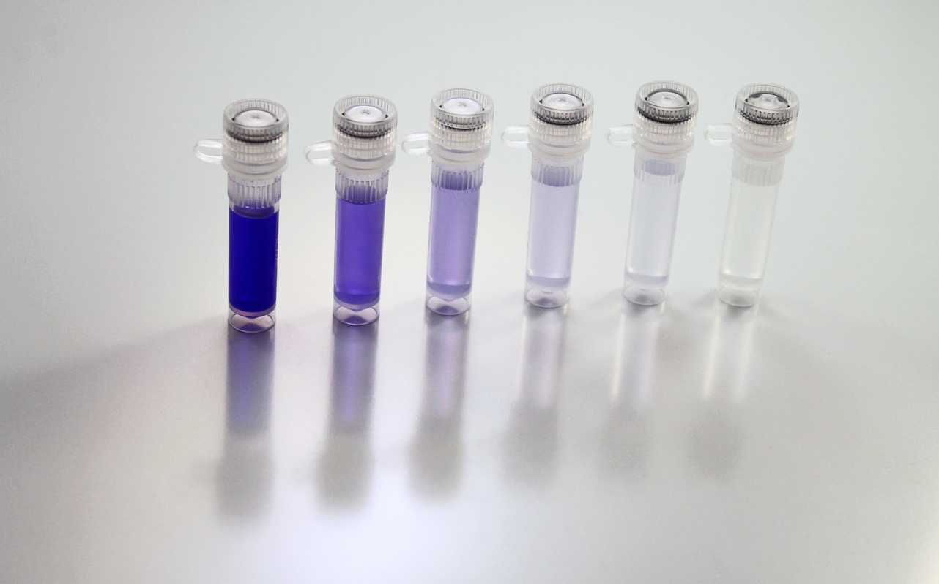
What does the coloured water represent?
What does the clear water represent?
What colour is your water?
Who is the bad friend in the room?
Who is the good friend in the room?
What does this demonstration show?

Slide 6


Prophet Muhammad SAW said, “A good friend is like a person carrying musk and an evil friend is like a blacksmith. The one who is carrying musk will either give you some perfume as a present; you will buy some from him; or you will at least find a lovely smell just by staying with him

Slide 7


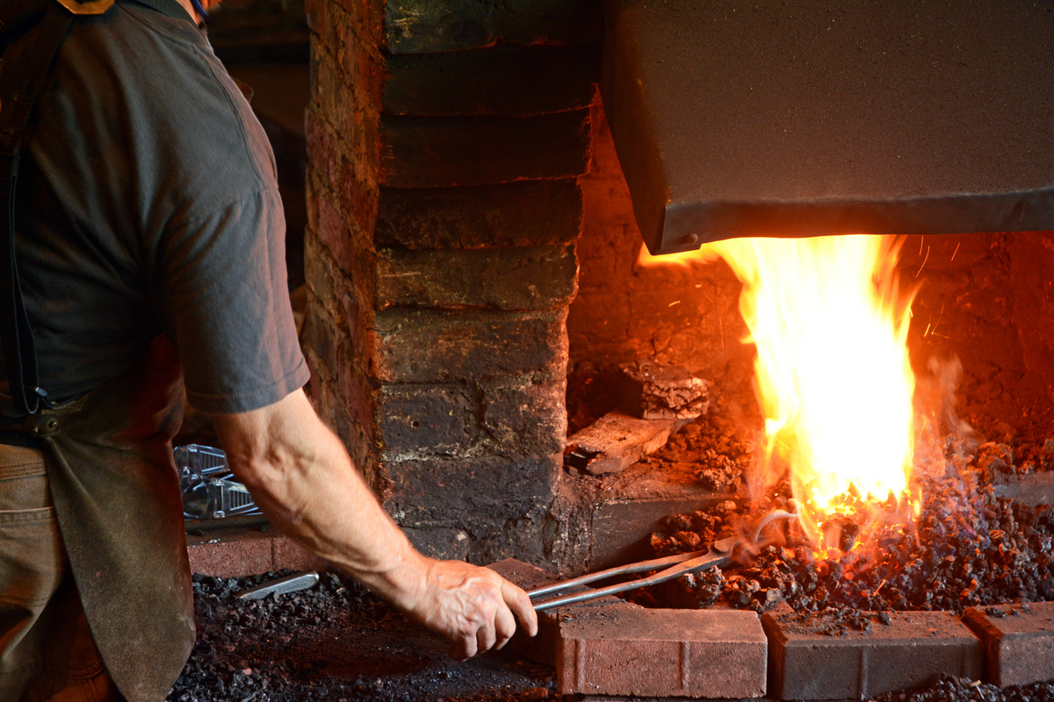

“However, the one who is a blacksmith will either burn your clothes or just by staying with him, you will find a nasty smell.”

Slide 8
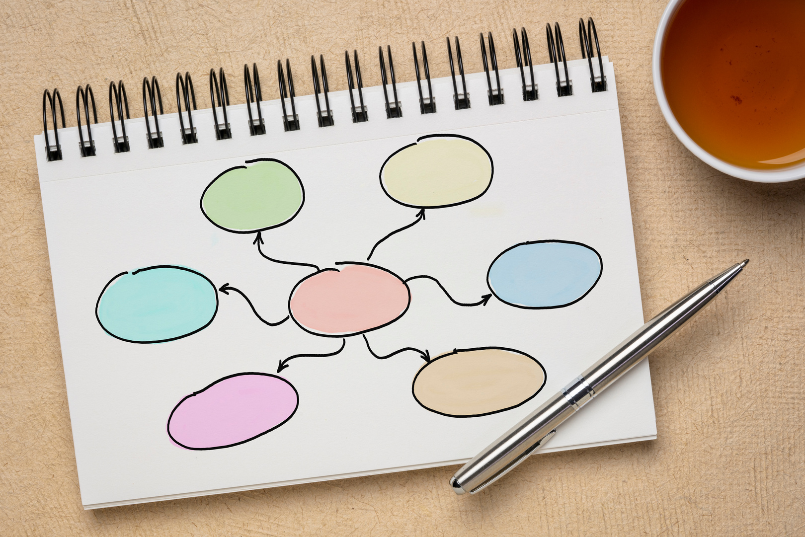

What makes a good friend?

Slide 9

  Trustworthy - Keeps your secrets
  Does good deeds and encourages you to do good deeds / Stays away from sin and encourages you to stay away from sin
  Increases your connection to Allah
  Has similar interests to you
  Empathetic - cares about your wellbeing
What is a friend?
( State 5 most important characteristics of a friend)

Slide 10
What makes a bad friend?

Slide 11


Why should we stay away from bad friends?

Slide 12


Safiya and Huda are sitting in the canteen at lunchtime. Safiya openly mixes freely with guys but Huda does not. 2 guys see Safiya and come and sit with them for lunch. What should do Huda do? How did she end up in this situation?
SCENARIO NUMBER 1

Slide 13
Tanisha and Joanne have been in the same class since year 7, and have been good friends. Joanne has recently come out in year 11 as a member of the LGBT community. Its PRIDE month and Joanne has asked Tanisha to wear the rainbow-coloured wristband to raise LGBT awareness. What should Tanisha do?
SCENARIO NUMBER 2

Slide 14
ARE YOU A GOOD FRIEND?

Slide 15

Shabana and Afiya have been best friends from primary school, and their mums are friends too. However, from year 9 - year 10 Afiya has started to change. Afya has started to snow share inappropriate pictures of herself on her public social media. What should Shabana do?
SCENARIO NUMBER 3

Slide 16
‘Amr ibn ‘Abasah reported: The Prophet, peace and blessings be upon him, said, “Allah Almighty said: My love is a right upon those who befriend each other for my sake. My love is a right upon those who defend each other for my sake.”

Slide 17

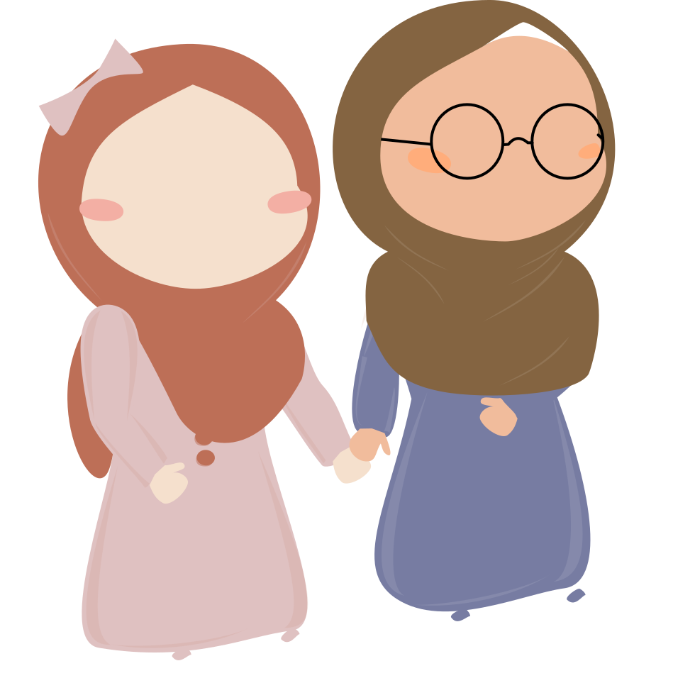

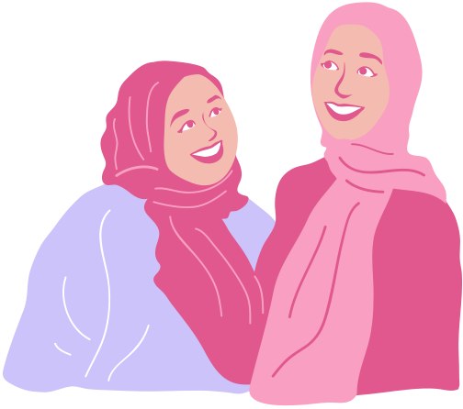

Plenary
Today I learnt that....
I feel more confident about....
The thing I enjoyed was...
I will change .....
I will act upon.....
I will go home and tell....

Slide 18
Useful teacher reading:
https://www.mindful-muslimah.com/how-to-teach-our-children-to-choose-better-friends/
https://seekersguidance.org/answers/general-counsel/friendship-with-non-muslims-explaining-verse-551/

