Slide 1

Wellbeing – The middle path
Sumiyya Iqbal

Slide 2
The Middle path
Extreme
Middle Path
Negligence

Slide 3
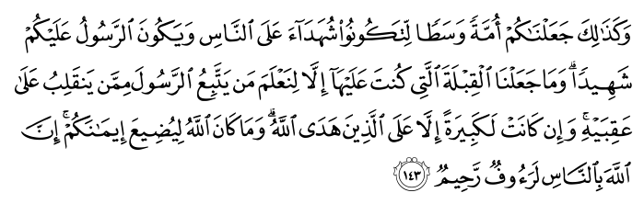

Allah Ta’alah says in the Qur’an:
“ We have made you a moderate nation so that you could be an example for all people and the Prophet an example for you.” (Surah Baqarah – Verse 143)

Slide 4
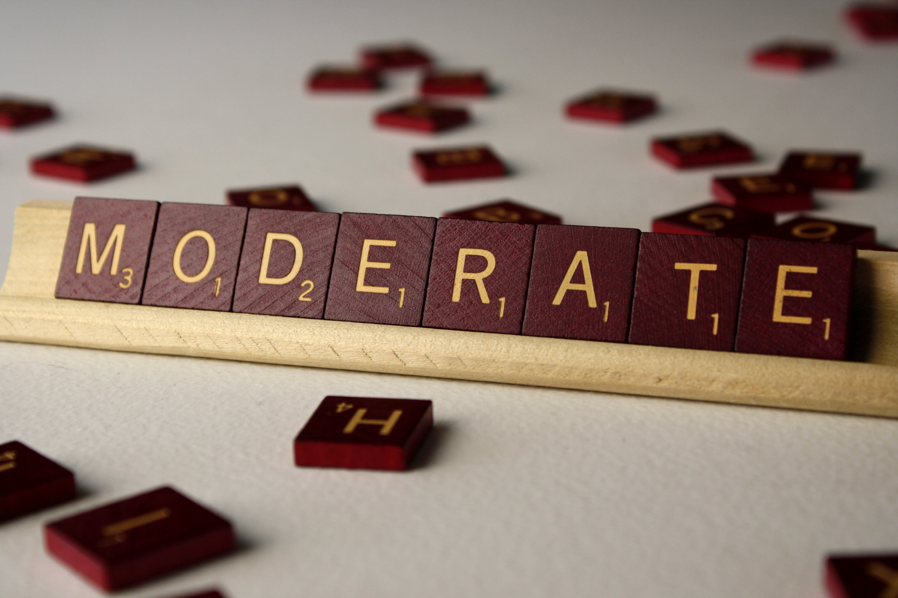
Can you give any examples

Slide 5
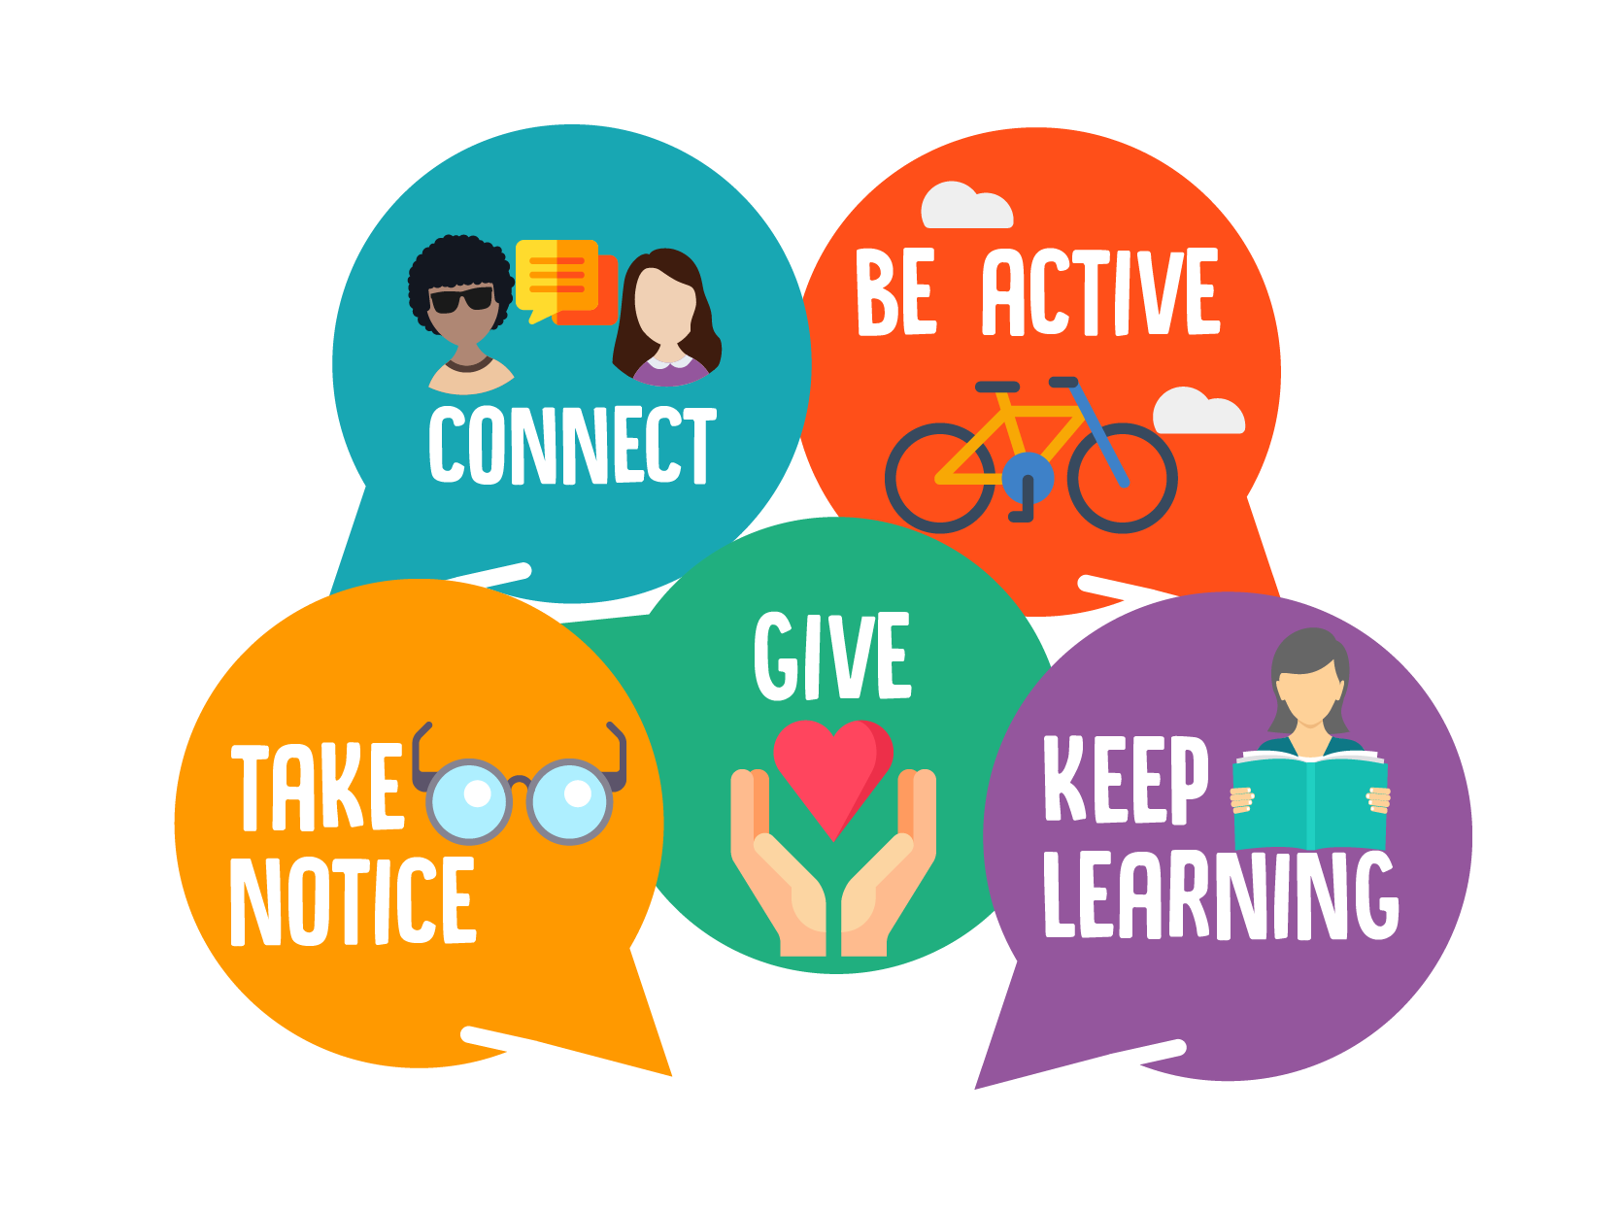
NHS – 5 steps to reach Mental Wellbeing

Slide 6
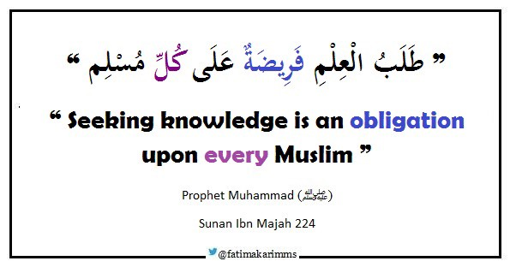
1. Keep learning

Slide 7
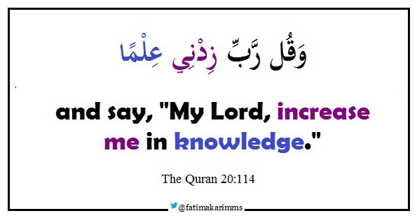
1. Keep learning

Slide 8
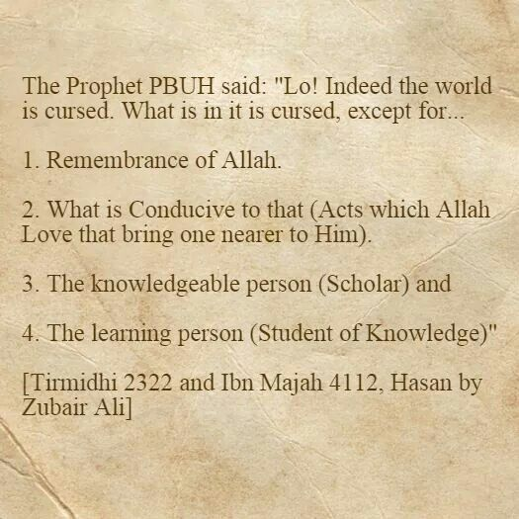
Which one are we ???

Slide 9
1. Keep learning
Try learning to cook something new. Find out about healthy eating and cooking tips
Try taking on a new responsibility at work/school, such as mentoring a junior staff member or improving your presentation skills
Work on a DIY project, such as fixing a broken bike, garden gate or something bigger. There are lots of free video tutorials online
Consider signing up for a course at a local college/Islamic instutite. You could try learning a new language or a practical skill
Try new hobbies that challenge you, such as writing a blog, taking up a new sport or learning to paint

Slide 10
2. Be active
Ibn ‘Abbas narrated that the Messenger of Allah (peace and blessings of Allāh be upon him) said: “Two blessings that many of the people waste are health and free time.” [Tirmidhi]
The Messenger of Allah (peace and blessings of Allah be upon him) said:
“Teach your children swimming, archery and horse riding”.
What's your hobby?

Slide 11




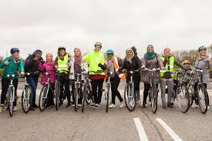
2. Be active
Find activities to help you get fit
Find out how to start swimming or cycling
Find out about getting started with exercise
Any more??

Slide 12
3. Give to others
Giving charity - “Allah, the Exalted, says: ‘Spend, O son of Adam, and I shall spend on you.’” – (Al-Bukhari and Muslim).
Giving time to friends and family – Abu Hurayrah (radi Allahu anhu) said that Prophet Muhammad (peace and blessings of Allah be upon him) said: “Whoever removes a grief from a believer from amongst the sorrows of this life, Allah will remove a grief from him amongst the sorrows of the Day of Resurrection. (Sahih Muslim)
Visiting the Sick - Prophet Muhammad (peace and blessings of Allah be upon him) said: “When the Muslim visits his (sick) Muslim brother, he is harvesting the fruits of Paradise until he returns.” (Sahih Muslim)
Giving gifts – Prophet Muhammad (peace and blessings of Allah be upon him) said: “Give presents to one another. Presents remove malice from the hearts, and a female neighbour should not regard the gift of a trotter (hoof) of a goat to another female neighbour as of no value.” (Tirmidhi)
Gratitude - Prophet Muhammad (peace and blessings of Allah be upon him) said: “Whoever failed to give thanks to anyone who did a favour to him failed to give thanks to God.”
How do you feel once you have helped someone?

Slide 13
3. Give to others
Some practical examples:
Saying thank you to someone for something they have done for you
Asking friends, family or colleagues how they are and really listening to their answer
Spending time with friends or relatives who need support or company
Offering to help someone you know with DIY or a work project
Volunteering in your community, such as helping at a school, charity organisation, hospital or care home
How is giving encouraged in Islam?

Slide 14
4. Stay connected
If possible, take time each day to be with your family, for example, try arranging a fixed time to eat dinner together
Arrange a day out with friends you have not seen for a while, or a family trip
Try switching off the TV to talk or play a game with your children, friends or family
Have lunch with a colleague
Visit a friend or family member who needs support or company
Make the most of technology to stay in touch with friends and family. Video-chat apps like Skype and FaceTime are useful, especially if you live far apart

Slide 15
4. Stay connected
Abu Huraira reported: The Messenger of Allah, peace and blessings be upon him, said, “A Muslim has five rights over another Muslim: to return the greeting of peace, to visit him when he is sick, to follow his funeral procession, to answer his invitation, and to respond to his sneeze.”
لَا يَدْخُلُ الْجَنَّةَ قَاطِعٌ
The Messenger of Allah, peace and blessings be upon him, said,
“The one who severs his family ties will not enter Paradise.”
(Ṣaḥīḥ al-Bukhārī and Ṣaḥīḥ Muslim)

Slide 16
5. Mindfulness
Paying more attention to the present moment can improve our mental wellbeing. This includes our thoughts and feelings, our body and the world around us.
Some people call this awareness "mindfulness". Mindfulness can help us enjoy life more and understand ourselves better. It can positively change the way we feel about life and how we approach challenges.

Slide 17
Mindfulness exercise – Raisin

Slide 18
5. Mindfulness
As the Prophet ﷺ defined in the famous hadith of Gabriel, spiritual excellence is “to worship Allah as if you see Him, for if you do not see Him, He certainly sees you.” (Al Bukhari)
As Muslims, when and where do we practise mindfulness?

Slide 19

Salah – Ultimate mindfulness
Be ever mindful of prayers, especially the middle prayer; and stand before Allah in total devotion” ( 2:238)
Mindful regarding its times
Mindful regarding what we are reciting in Prayer
Mindful of our concentration in prayer – Khushoo
Mindful of our state of purity
Mindful of our actions
Mindful in our Dua

Slide 20
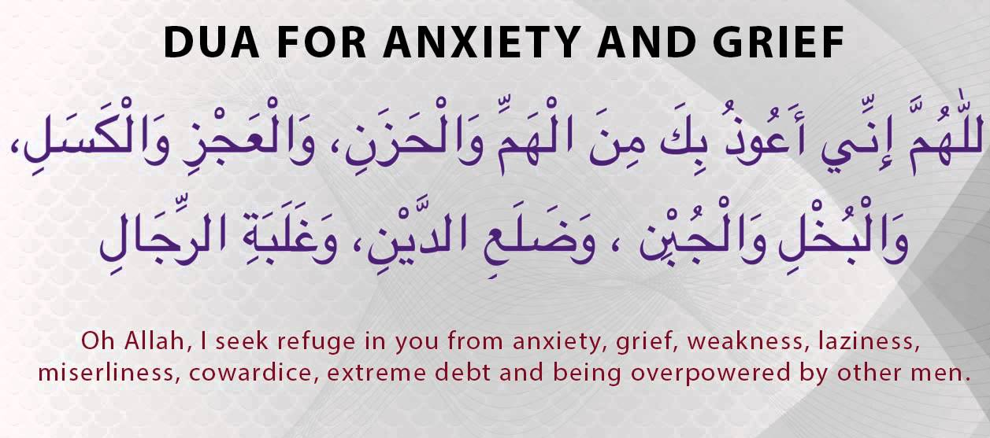

Slide 21
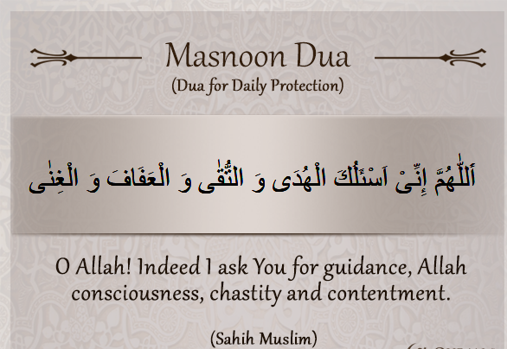

Slide 22
NHS – 5 steps to reach Mental Wellbeing

