Slide 1
Session 2
What prevents us from being productive?

Slide 2




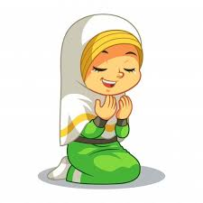

Productivity
Sumiyya Iqbal

Slide 3
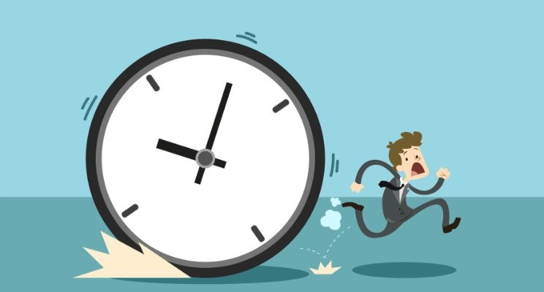
What prevents us from being productive?
Mentimeter

Slide 4
Procrastination
3 types of Procrastinators:
Fun procrastinator
‘Plenty of time’ procrastinator
Perfectionist procrastinator

Slide 5
Ways to beat procrastination:
Self–Discipline
Be your own cheerleader
Du'a
Eat the frog

Slide 6

1. EAT THE FROG!
Notes:
Ways to stop procrastinating and get more things done faster

Slide 7
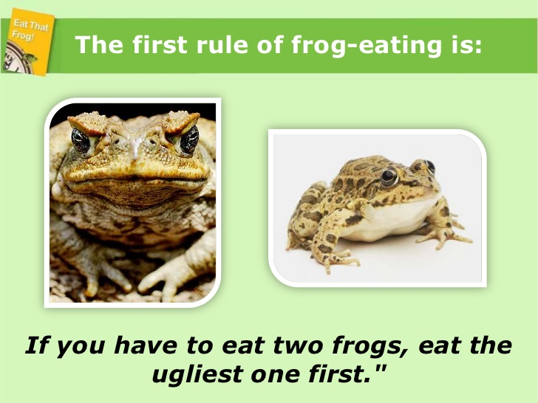
Which frog would you eat first?
A B

Slide 9

What is your FROG?

Slide 10
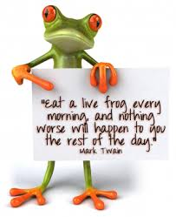

Slide 11

ABCDE Method
Think on paper
A – Must do – FROGS
B – Should do - TADPOLES
C – Nice to do
D – Delegate
E – Eliminate
Take action immediately
Notes:
A –will have serious positive or negative consquences if you do it or fail to do it
The frogs of your life
B – Mild consquences, tadpoles. Never do an B task, when A is left unfinished
Never be distracted by a tadpole when a frog is sitting there waiting to be eaten
C – nice to do, but no conquences at all if you do it or not, ##. Eg. Phoning a friend
D – Delegate – free up A task for you
E – get rid of it, it may have been important at one time but no longer is

Slide 12
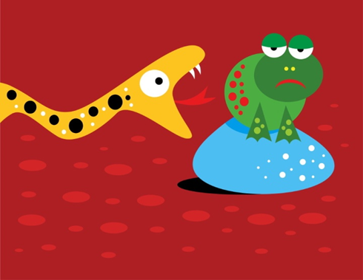
Get started on your ‘FROG’ task NOW!
Start it and stay on it, till it is complete
Eat the whole frog and don’t stop until it’s finished

Slide 13
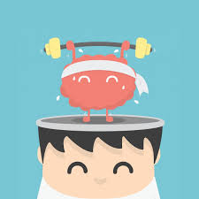
2. Self - Discipline
SELF-DISCIPLINE is ‘doing what needs to be done even if you don’t want to do it’
Notes:
Your test – to sit down with a task and not to move until you have completed it, activity?

Slide 14
The ONLY difference between a productive Muslim and a unproductive person is their level of Discipline

Slide 15

Self – Discipline
Your nafs –ego
Prefers to do nothing
Need to tame it
Practise….Practise…. Practise….
One habit at a time
Set consequences for your actions
Build it in to your routine

Slide 16

3. Be your own cheerleader
Motive yourself to be the best you can be
Have to be completely optimistic
Control your thoughts
Say things like ‘I can do this’
Optimistic people:
  look for the good in every situation
  seek a valuable lesson in every difficulty
  look for a solution to every problem
  think and talk continually about your goals

Slide 17
4. Power of Du’a
Only Allah alone can help us
Turn to him
He will help you
Small matters also need Du’a
Gives you strength
He in in charge of our affairs
Du’a + Action

Slide 18
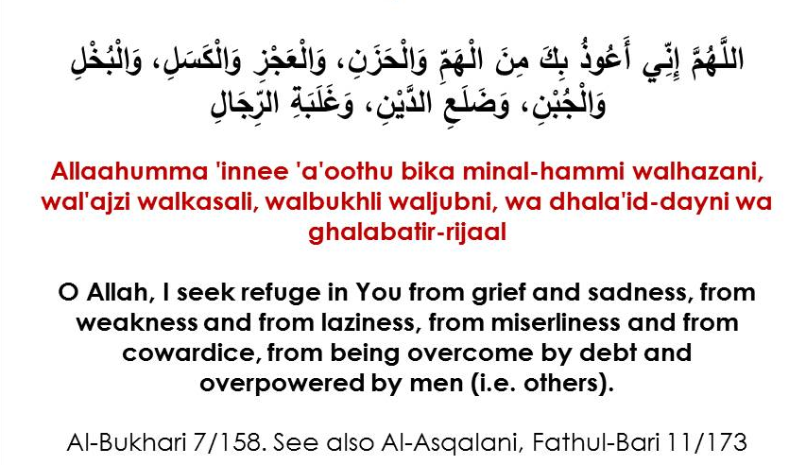
Anti-Productivity Du’a

Slide 19


A PRODUCTIVE ‘NEW’ YOU

Slide 20

Recap

Slide 21



Resources
WEBSITES
https://productivemuslim.com/
https://barakahacademy.com/
BOOKS
‘Eat that Frog’ by Brian Tracy
‘The Productive Muslim’ by Mohammad Faris
‘Value of time’ by Shaykh ‘Abd al-Fattah Abu Ghudda
VIDEOS
Procrastination monkey:
https://www.ted.com/talks/tim_urban_inside_the_mind_of_a_master_procrastinator
24 hour routine: https://www.youtube.com/watch?v=ylpVqYKw0jA

Slide 22
Productivity
Sumiyya Iqbal

