Slide 1

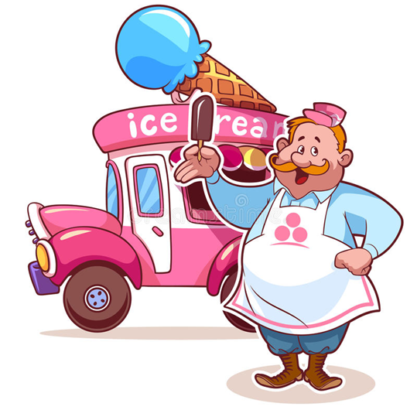
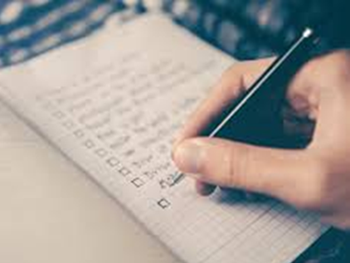

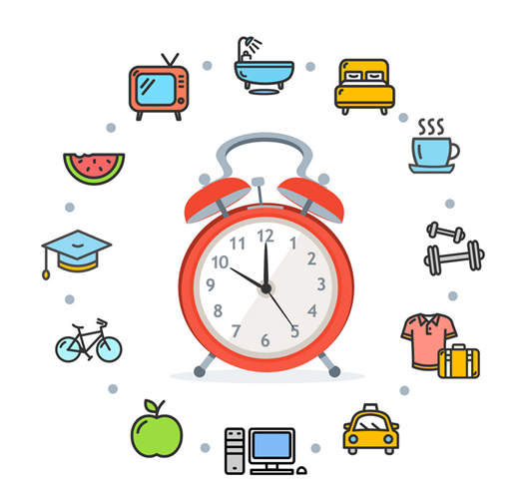
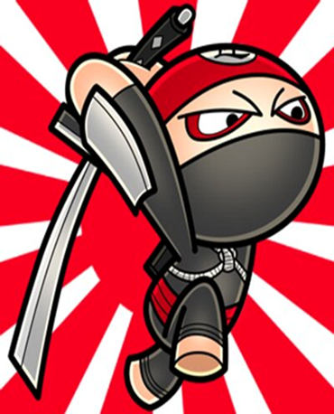
Productivity
Sumiyya Iqbal

Slide 2
Structure of the sessions
Why do I need to be productive?
What can I do with my time?
Methods to increase productivity
What prevents us from being productive and how to tackle it

Slide 3
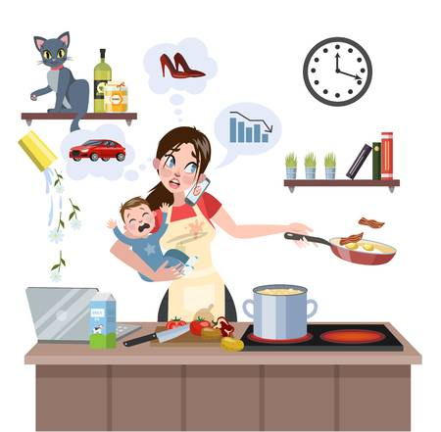
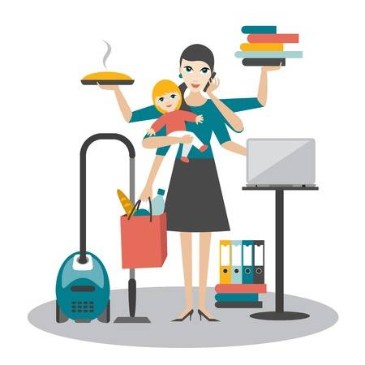
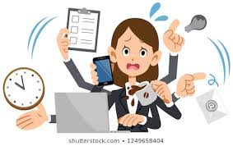

Busy Vs Productive

Slide 4
Why do I need to be productive?
This world is preparation for the next world
Surah Al-Asr
5 before 5
Keeps us away from wrong
Helps boost our mental health

Slide 5
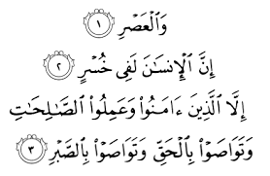
Surah Al-Asr
I swear by the time (1) man is a in a state of loss indeed, (2) except those who
believed,
and did righteous deeds,
and advised each other for the truth,
and advised each other for patience (3)
4 true keys to success

Slide 7


Slide 8
Time is an Amanah (a trust) from Allah
The Holy Prophet (peace be upon him) said: “The feet of a servant will not touch the ground until he asked about his life and how he spent it; his knowledge and how he acted upon it; his wealth and how he acquired it and spent it and his body and how it was used.” [Tirmidhi]

Slide 9
Idle mind is Shaytaan’s workshop
Imam Shafi’i who famously expounded two principles of time management:
“Time is like a sword: if you don’t cut it, it will cut you. Second is yourself: if you don’t busy it with right, it will busy you with wrong.”

Slide 10
Ways to be productive
To do lists
Break down tasks
Routines
Planning

Slide 11
Planning
Plan every day in advance
Proper Prior Planning Prevents Poor Performance
Save yourself time where you can
Think ahead

Slide 12
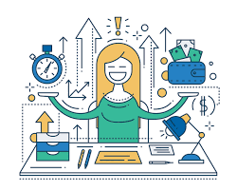
You don’t need to do everything – BURNOUT

Slide 13

To do lists
The power of writing
MIT’s – Most important tasks of the day
The feeling of ticking off the task
ABCDE method

Slide 14

ABCDE Method
Think on paper
A – Must do
B – Should do
C – Nice to do
D – Delegate
E – Eliminate
Take action immediately
Notes:
A –will have serious positive or negative consquences if you do it or fail to do it
The frogs of your life
B – Mild consquences, tadpoles. Never do an B task, when A is left unfinished
Never be distracted by a tadpole when a frog is sitting there waiting to be eaten
C – nice to do, but no conquences at all if you do it or not, ##. Eg. Phoning a friend
D – Delegate – free up A task for you
E – get rid of it, it may have been important at one time but no longer is

Slide 15
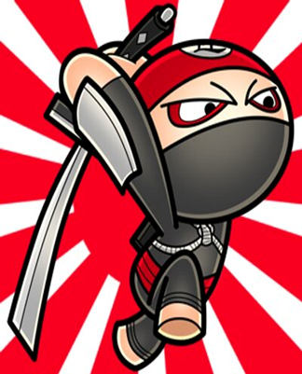
Break down tasks - Take it one oil barrel at a time, slice and dice the task
Take one step at a time
One bite at a time
The task will become manageable
Less likely to procrastinate
SLICE YOUR BIGGEST TASK
Notes:
How do you save money, or write a book or record a TV Programme
Students then choose the biggest task, and break It into smaller chunks, more manageable

Slide 16
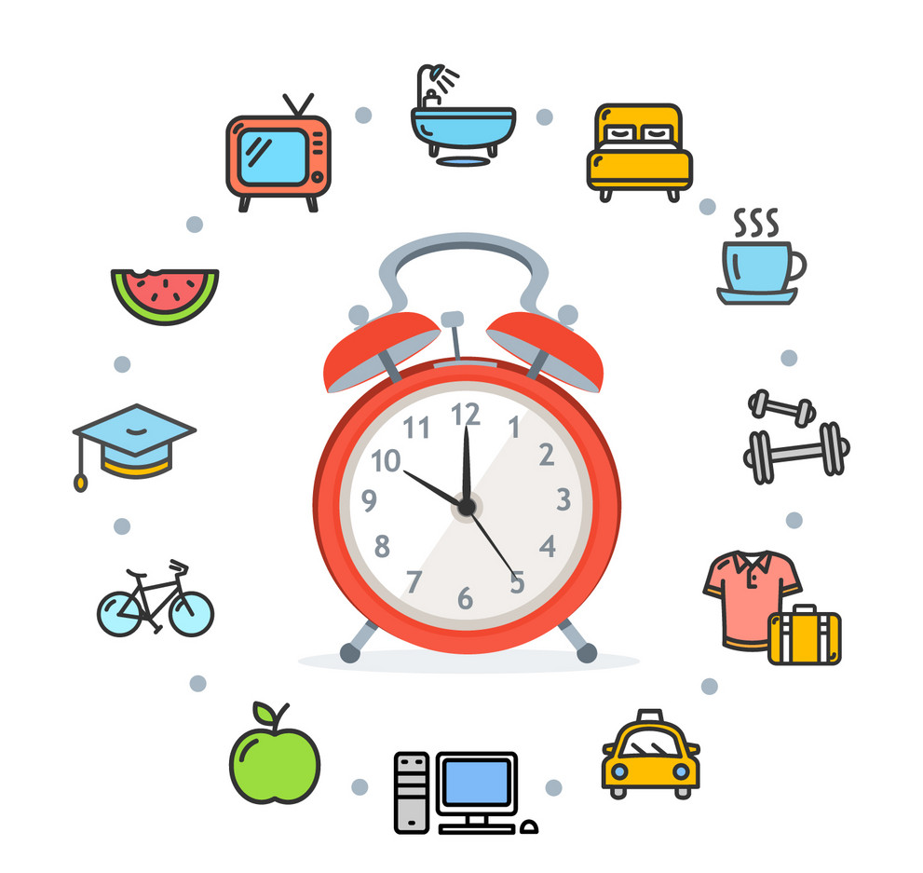
ROUTINES
What time do you wake up?
What time would you like to wake up?
Are you eating your meals on time?
How long are you spending on social media?
Where is the Qur’an in your routine?
Do you exercise? If so, how often?
How much time are you spending with family?
What time are you going to sleep?

Slide 17
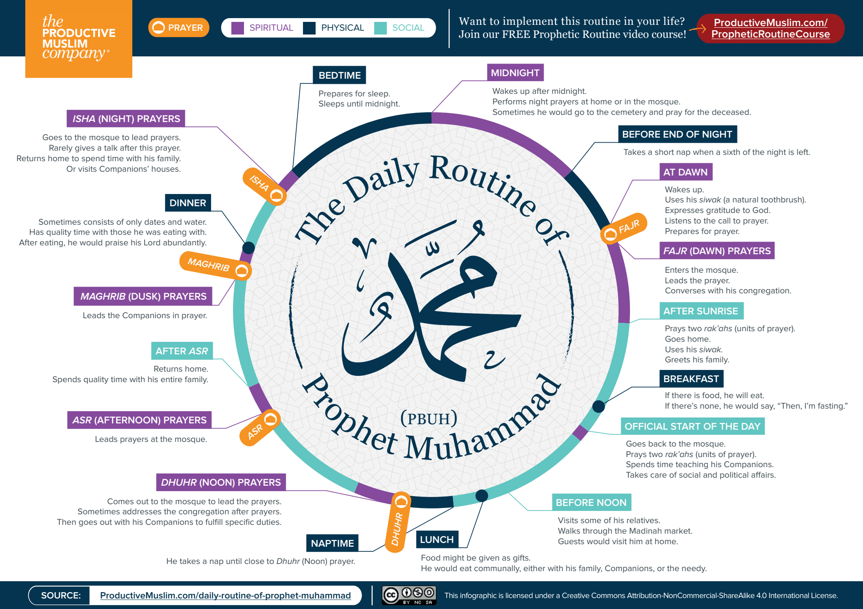

Slide 18
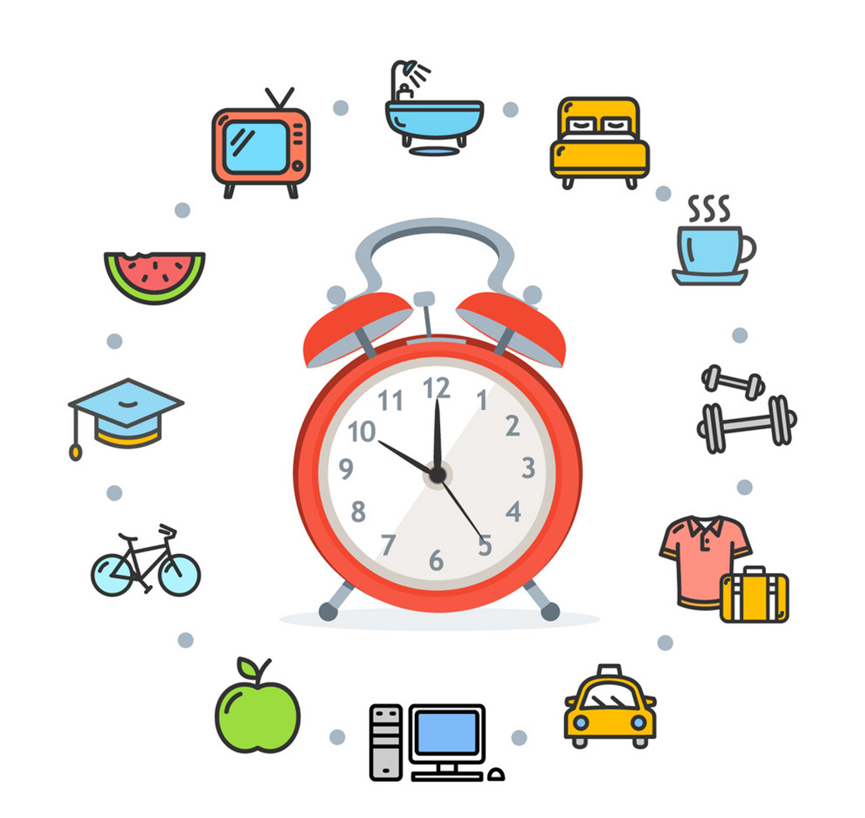

Recap

Slide 19
Q&A

