Slide 1

Surah Talaq
The Divorce – 12 Verses

Slide 2
This Surah also known as…
Surah An Nisa
Surah As Sughra
The short Surah Nisa
As this Surah deals with the issues of Divorce in Islam
Divorce is allowed in Islam but the detested in the sight of Allah
Prophet Muhammad (May Allah’s peace and blessings be upon him) said: “Marry and do not divorce, because divorce causes the throne of the All Merciful to shudder”

Slide 3
Rule 1 – Divorce your wife at the time when her iddah can start – Verse 1
When she is not pregnant
When she is not on her menstruation
Divorce should be given when she is in her cleanliness and not have had intercourse with her husband
Why??? This is so her waiting period is not extended and causes her harm
Ensures that divorce is not due to some sort of revenge or anger

Slide 4
Rule 2- Count the Iddah – verse 1
Responsbility of Men and women
To keep a count of the days of waiting
3 clean / 3 periods

Slide 5
Rule 3 – Do not expel them from their houses – Verse 1
She has full right to stay in her husbands house
Does not need to go out unnecessarily
He has a responsibility over her till the waiting period is over
Unless she commits a shameless act or uses indecent speech

Slide 6
Rule 4 – When iddah has finished can stay with them, or part with them
If he wants to keep her, he calls two witnesses and revokes the divorce (if less than 3 divorces are given)
If he wants to end the marriage, it should be done with dignity and respect, witness should also be called, to prevent any dispute in the future
No physical or verbal abuse
No breaking of ties
Even Mustahab to give her a gift (clothes) at the time of her leaving the house
What is the best way to give divorce?

Slide 7
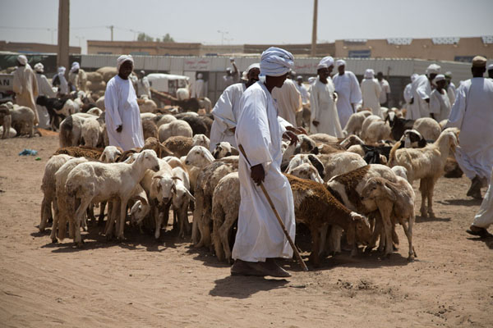
Verse 2/3 – Taqwa – fear Allah
This verse was revealed because..
Auf bin Malik Ashjai came up to the Prophet Muhammad (May Allah’s peace and blessings be upon him) and said enemies had captured his son
His wife was very anxious and wanted to know what to do
Prophet Muhammad (May Allah’s peace and blessings be upon him) advised them to keep praying ‘La hawlawala quwata illa billah’
They did so
One day, the enemies were not being mindful and the boy managed to escape
He either bought a herd of goat or mounted one of their camels and made it back to his father
Auf (ra) reported this incident to the Prophet Muhammad (May Allah’s peace and blessings be upon him) and inquired if the goats/camels were lawful for them
This verse was then revealed

Slide 8

Remedy for calamities
One day the Prophet Muhammad (May Allah’s peace and blessings be upon him) continuously recited this verse until the reporter started to feel sleepy. The Prophet Muhammad (May Allah’s peace and blessings be upon him) said:
‘Abu Dhar if all people only choose this verse, it would be sufficient for them all’

Slide 9

Verse 3 - Taqwa
Reliance on Allah
70,000 followers will enter Jannah with out accountability and one of their qualities will be having trust in Allah
5 blessings of Taqwa
He will be given a way out difficulties
He will be provided with all his needs from a way he did not expect
Allah will make his matters easy for him
Allah will forgive his sins
Allah will grant him great reward

Slide 10
Rule 5 – Iddah timings
Mensruation women – 3 periods
In doubt = 3 months
Non menstruating women = 3 months
Pregnant women = until baby is born

Slide 11

Rule 6 – pregnant women – verse 6
Husband needs to provide for wife and child during Iddah
If she feeds they baby – you have to pay her
With fairness
A just fee
Even if the wife is wealthy, the husbands duty id to spend on her.

Slide 12
Verse 8 -12
Severe account and Severe punishment of the hereafter
Allah has sent you down a reminder

Slide 13
Verse 12 – 7 earths
Quran didn’t tell us where, how, what they are
So we do not need to research it too much either
Policy of pious predecessors ‘ Leave unexplained what Allah has left unexplained’

