Slide 1
Surah Mujadalah
The debate
Madani Surah

Slide 2
Cause of revelation
Verse 1-6
Aus bin Samit (ra) said to his wife Khaulah bint Thalabah ‘You are to me like the back of my mother’ = Zihaar
Meaning you are unlawful for me like my mother
I cannot have relations with you
In the time of Ignorance, saying such a things = divorce forever
She went to the Prophet Muhammad (May Allah’s peace and blessings be upon him) for advise but he said he has not received any order from Allah on this matter
She pleaded to Allah – Oh Allah! I direct my complaint to you
Allah heard her complaint and reveled the rule of Shariah to help her
This rule has been engraved in the Quran for all to follow

Slide 3
Khaulah (ra)
For her the verses of Quran were revealed
For her this evil practise was abolished
Umar (ra) was once travelling with companions when he came across a women who stopped him. He stopped and listened to her. He did not move until she completed what she wanted to say. Some companions said: You have held back a large group of people just for an old lady
Umar (ra) said: Do you know who this lady is? She is Khaulah (ra), they lady whose complaint was heard in the 7th heavens. How can I not listen to her?
He said if she did not take leave according to her own accord, I would have stood with her here till nigh fall (ibn kathir)

Slide 4
Mujadalah
To pleade, to argue, to dispute consistently

Slide 5
Expiation for Zihaar
Free a slave
Keep fasts for two months
Feed 60 poor people

Slide 6
Once the verses were revealed
The Prophet Muhammad (May Allah’s peace and blessings be upon him) called Khaulah (ra) husband
He was a weak sighted old man
The Prophet Muhammad (May Allah’s peace and blessings be upon him) recited the verses to him
He was told to free a slave, he said he does not have the means to do that
He was told to fast for 2 months , he said if he does not eat 2/3 meals a day he looses his sight
He was told to feed 60 people, he said he does not have the ability to do that unless you help me
The Prophet and some other companions gave him food, enough to feed 60 people

Slide 7

Verse 7 - Cause of revelation
Peace agreement between the Jews and the muslims
When a companion would pass a group of Jews, they would start speaking in secret, prompting one to believe that they were plotting to harm or hurt him
The Prophet Muhammad (May Allah’s peace and blessings be upon him) advised them to give up their secret plots and conspiracies but they did not heed
This verse was revealed

Slide 8

Verse 8 – Cause of revelation
When the Jews came to see The Prophet Muhammad (May Allah’s peace and blessings be upon him) they would invoke curses on him by twisting their greetings
Assamu Alykum – May death be upon you
This verse was the revealed

Slide 9

On one occasion -
Hadrut Aisha(ra) heard them say this and she said: “death to you, and the curse of Allah be upon you, and his wrath!”
The Prophet Muhammad (May Allah’s peace and blessings be upon him heard this and said: “Oh Aisha! Allah does not like rudeness and foul speech”
She said ‘did you not hear what they said’
The Prophet Muhammad (May Allah’s peace and blessings be upon him said: “did you not hear my answering them back by saying wa alykum ‘same to you’”
Even when someone is rude to you, you should adopt the noble and soft way

Slide 10
Verse 11
The Prophet Muhammad (May Allah’s peace and blessings be upon him) was sitting in the mosque with a large gathering of people
Some of the companions who participated in the battle of Badr arrived a bit late
No one moved up to give them space and they could not find any space
The The Prophet Muhammad (May Allah’s peace and blessings be upon him) asked some people to stand up and leave
The hypocrites found this objectionable

Slide 11
Etiquettes of a gathering
Make room for others
Should make room for latecomers
When you are asked to stand and leave, you should leave
Latecomer can not ask someone to get up and then he take his space
If two people are sitting together, you should not come and sit in between them

Slide 12
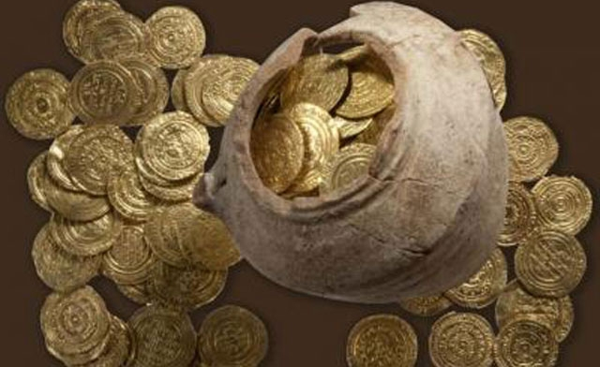
Verse 12 – cause of revelation
Some wealthy people used to come to The Prophet Muhammad (May Allah’s peace and blessings be upon him) and consult with him in private for a long time
This would in convince him and the poor people would not get time to consult him
This verse was revealed
They were asked to give some charity before the consultation
This stopped time wasters from taking up the time of The Prophet Muhammad (May Allah’s peace and blessings be upon him)

Slide 13
Verse 13 – Cause of revelation
Due to the revelation of verse 12, people even stopped necessary consultation with the Prophet Muhammad (May Allah’s peace and blessings be upon him)
So V13 was revealed
Clarifies that if you don’t have anything to give it is ok, you can still consult The Prophet Muhammad (May Allah’s peace and blessings be upon him) if you need to
The coming of Verse 13 abrogates Verse 12
Only Ali(ra) acted upon Verse 12, no one else was able to do so due to the financial constraints. Ali (ra) gave 1 dinar to meet privately with the prophet.

Slide 14
Verse 14
The hypocrites formed secret alliances with the Jews
Not permissible to have Muwalah - intimate friendship with a non believer
Different core values
You can have Muwasah – relationship based on Sympathy, kindness and concern
But it should not effect your religion

Slide 15
Verse 14 – They swear false oaths
Reason for revelation
Prophet Muhammad (May Allah’s peace and blessings be upon him)
Was sitting with his companions and said to them: “soon a person will come to you, whose heart will be the heart of a tyrant, and who sees through shatyaans eyes.”
Soon Abdullah ibn Natal (hypocrite) entered
Prophet Muhammad (May Allah’s peace and blessings be upon him asked him why do you and your comrades use obscene words against me
He swore that he did not do that. The he called his comrades and they all took a false oath that they did not do that.

Slide 16
Verse 22
The bond of faith is much greater than any other bond
Even above the bond of parents, siblings and spouses
Many examples of the companions
When their own fathers and brothers have attacked Islam, they stood with Islam and went to war with their blood relatives. Even killed them.
eg. Abu Ubaidah fought his father in the battle of Uhud, he tried to avoid him, but when faced with him, he killed him.

