Slide 1
Modesty
External modesty

Slide 2
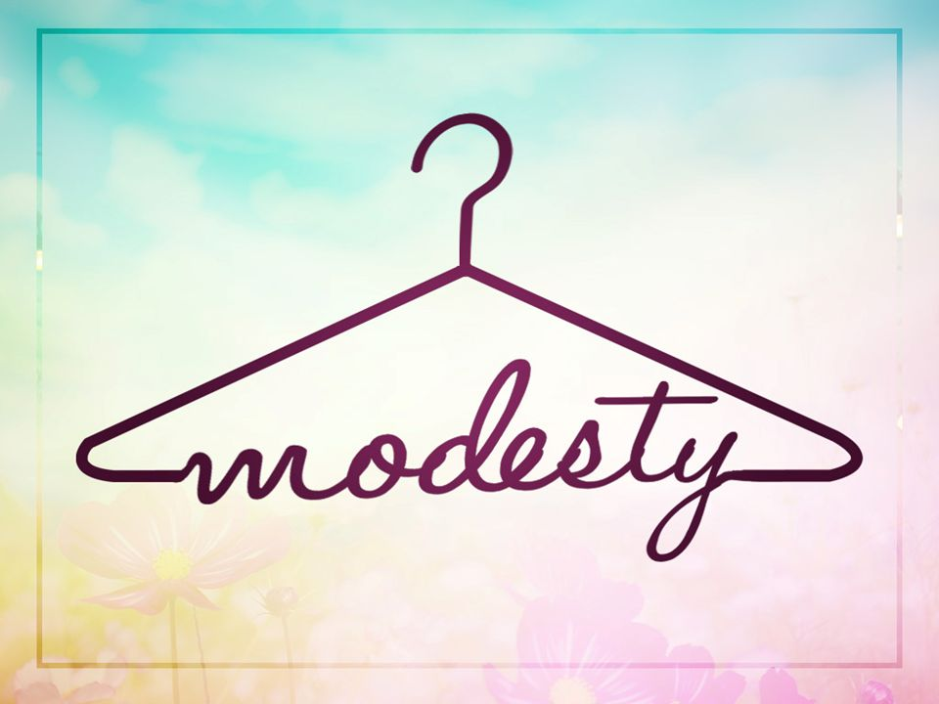
Define Modesty
Brainstorm definitions as a class

Slide 3
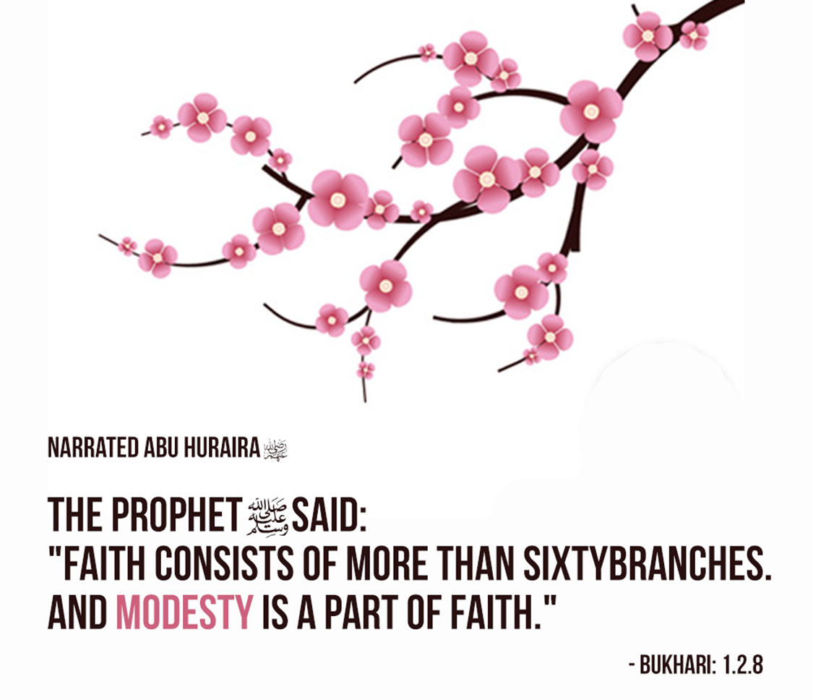
Modesty

Slide 4
In which areas of life can you be modest?
Types of Modesty :
Dress
Conduct
Heart
Speech
Worship
How can you be immodest/modest in each type

Slide 5
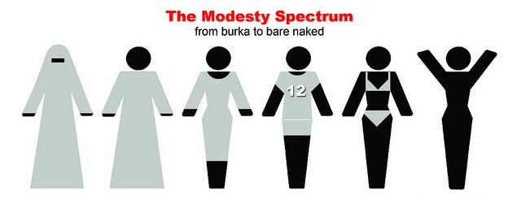
Modesty in dress

Slide 6
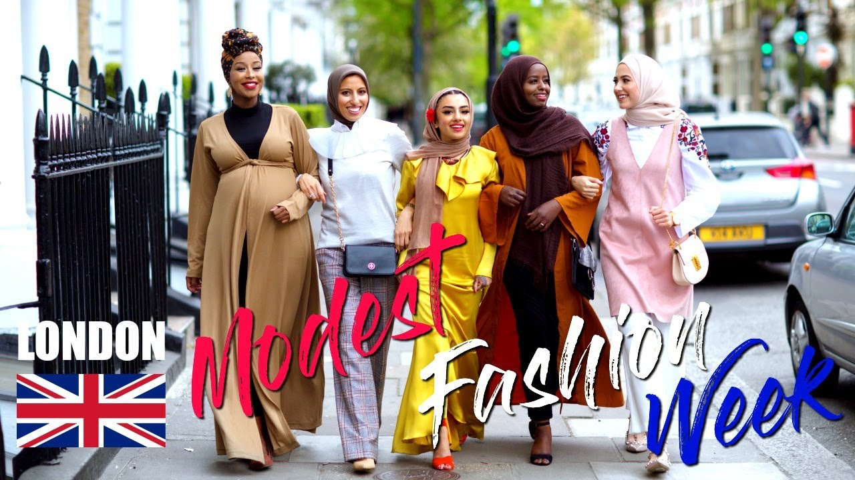
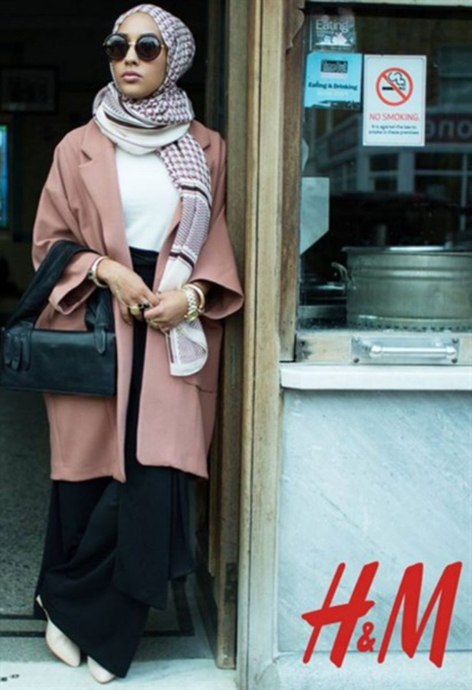
Modesty cards
Look at the images and categorise them into modesty / immodest dress?

Slide 7

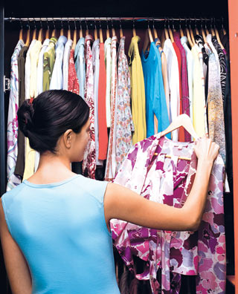

Can you come up with 4 questions to ask yourself when deciding what to wear/ buy?

Slide 8
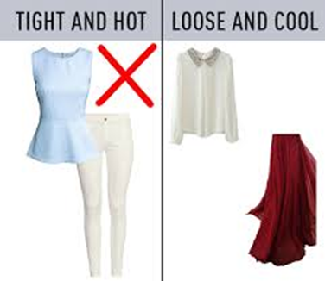
Can you come up with 4 questions to ask yourself when deciding what to wear/ buy?
1. Is it tight or loose around my body?
2. Is it see through?
3. Is it an attractive?
4. Does it cover my awrah?

Slide 9
What is your awrah?
Inside prayer – Whole body except face, hands and feet
Outside prayer – The awrah is..
Non Mahrams | Mahrams | Muslim women only | Non muslim women | Husband | In seclusion
Whole body except the face, hands and feet | Navel to knees and stomach and back | Navel to the knee | Navel to the knee | No awrah | To be covered from navel to knee
Feet are allowed to be exposed up to the ankles Difference of opinion between the feet and face | Including knees |  | Unless you fear fitnah and should only uncover if need to | It is disliked to be completely naked | Except when there is a need eg. Showering, changing clothes…

Slide 10
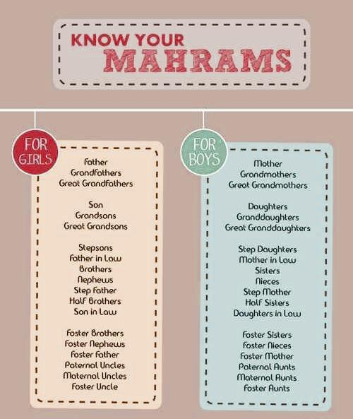
Who are your mahrams?
Your Father
Grandfather
Brother
Son
Paternal uncle (father’s brother)
Maternal uncle (mother’s brother)
Father in-law
Grandson
Husband’s son (from another marriage)
Son in-law

Slide 11
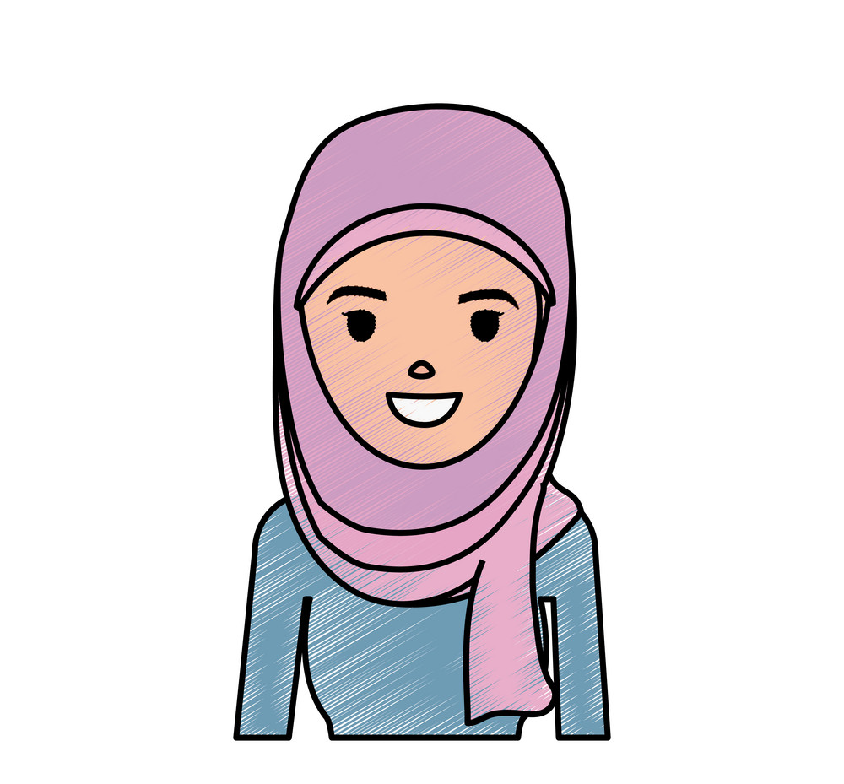
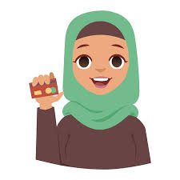
The Hijab
Why do you wear/not wear it?

Slide 12
Where does the hijab come from?
"And tell the believing women to cast down their glances and guard their private parts and not expose their adornment except that which [necessarily] appears thereof and to wrap [a portion of] their head covers over their chests and not expose their adornment except to their husbands, their fathers, their husbands' fathers, their sons, their husbands' sons, their brothers, their brothers' sons, their sisters' sons, their women, that which their right hands possess, or those male attendants having no physical desire, or children who are not yet aware of the private aspects of women." -Quran 24:31.
“O Prophet! Say to your wives, your daughters, and the women of the believers that: they should let down upon themselves their jalabib.” -Quran 33:59. Jalabib is an Arabic word meaning "loose outer garment".

Slide 13
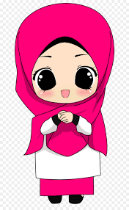
Benefits of the hijab?
Please Allah
Gaining reward
Reminds you who you are
Your stamp of Islam
It should preserve your chastity
Allah makes you more honourable through it

Slide 14
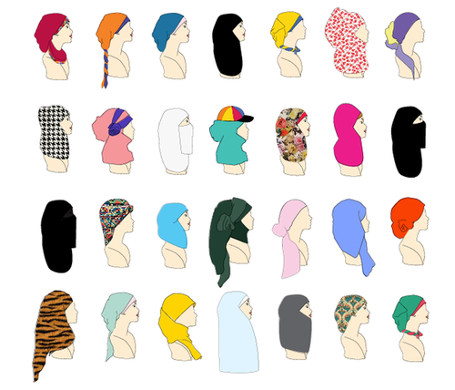
Which is correct?

Slide 15
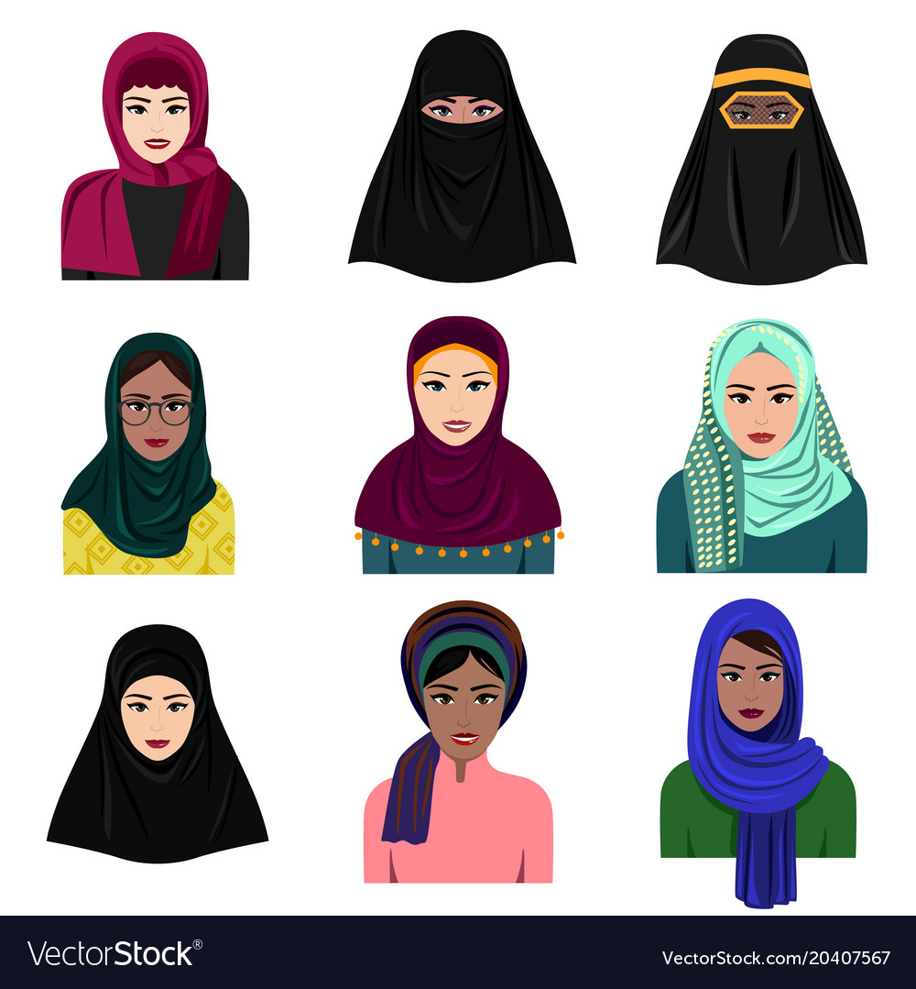

Slide 16
Modesty cards
Look at the images and categorise them into modesty / immodest dress?

