Slide 1
Internal Modesty - Hayaa
Subtitle

Slide 2
Quick Quiz
What did the word Awrah mean?
What is your awrah infront of non – mahram men?
What is your awrah infront of Mahram men?
What is your awrah Muslim Women?
What are the 4 questions we should ask ourselves regarding our clothing before we leave the house?
Where is the commandment of the hijab found?
What is the benefit of wearing the hijab?

Slide 3
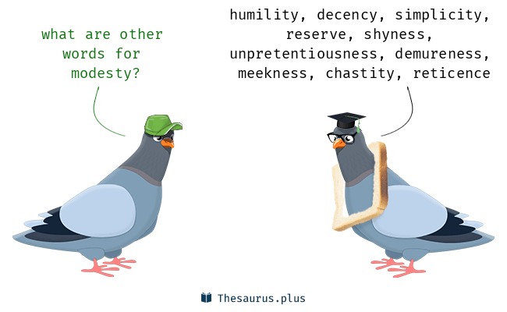
If your internal is Modest, so will your external

Slide 4

Haya
Haya plays a huge part in our imaan
Abdullah ibn Umar (ra) narrated that the Prophet (saw) said: "Indeed haya (modesty) and Iman are Companions. When one of them is lifted, the other leaves as well." (Baihaqi)

Slide 5

Haya
Life
Life of the heart - modesty, shyness, self-respect, bashfulness, shame, honour, humility
It keeps him/her from being neglectful in giving everyone what is due upon them, and if for any reason he/she is not able to keep up with his/her commitment then they will feel extremely uncomfortable and ashamed about this. The reason being that he/she will have displeased Allah by breaking a commitment.

Slide 6
Just for women ?
We also learn from the Prophet (saws) the importance of having haya and how it is not something to be ashamed of, but instead, one should be concerned and ashamed if they do not possess it within their character.
Narrated Abdullah ibn Umar (ra): The Prophet (saws) passed by a man who was admonishing his brother regarding Haya and was saying, "You are very shy, and I am afraid that might harm you." On that, Allah's Apostle said, "Leave him, for Haya is (a part) of Faith." (Bukh

Slide 7
Good and Bad Haya
Good Hayâ' is to be ashamed to commit a sin or a thing which Allah and His Messenger (saws) has forbidden
E.g. Embarrassed in front of Allah if you were disrespectful to parents
Bad Hayâ' is to feel ashamed to do a thing, which Allah and His Messenger (saws) ordered to do
e.g. Embarrassed in front of friends to wear hijab
Notes:
Can you create 5 more examples of each category of Haya

Slide 8
Levels of Haya
Allah
Yourself
Other human beings
Notes:
Lowest – Haya infront of other people = eg. Before literring you check if anyone else is around you – This is the lowest level but with out this you are even worse because at least you care not to publise your sins infront of all. Todays social media – Sins are posted for all to see
Next up is Haya with your own self – you have self worth/ self dignity = you are all alone buts till you decide not to commit this sin because you know you are better than this
Highest level is haya with Allah – You have Ihsaan – Even though you do not see Allah, you know he sees you!

Slide 9


Lowest of the low
If have no Haya – Do as you please
There is nothing to stop you
No limits

Slide 10
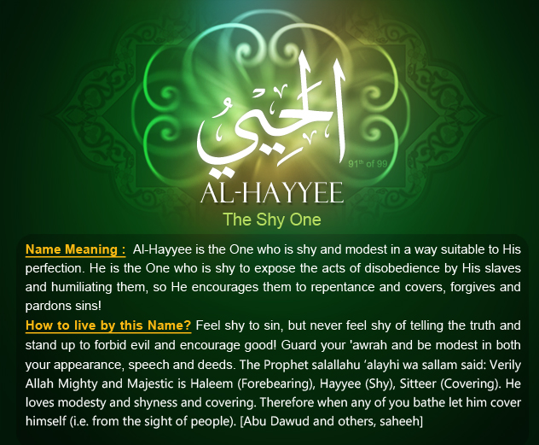
Even Allah has Haya
Notes:
Even Allah has Haya – to a degree that befits him – so what about us!

Slide 11
Our frame of mind
Allah is always watching us
We must be shy of doing ANYTHING displeasing to Allah (swt)
We should be brave and bold to follow the commandments of Allah
We shouldn’t publicise our sins in person/social media

Slide 12
How can you have Haya in these aspects of your life . A3 brainstorm – You will be moved around the room every 2mins, give examples too!
Types of Modesty :
Dress
Interactions
Thoughts
Speech
Worship

Slide 13
What questions would come to your mind, before committing any of these actions? Use the levels of Hayaa pyramid, what would be your thought process? Choose one situation from each side
1. Being disrespectful to your parents
2. Getting your eye brows done
1. Helping our a sister in need who is not so popular and getting bullied
3. Telling a lie to the headteacher
2.Praying Salah in a open public
4. Taking drugs
6. Helping your parents despite having so much work to do
3.Speaking the truth against your best friend
5.Giving a guy your number / accepting him on social media
4.Wearing Hijab to school for the first time
6.Wear non modest clothes
7.Listening to music
5. Listening to Quran recitation on your headphones
8.Watching something inappropriate but trending

Slide 14
WHAT IS INTERNAL HAYA?
You may use the following words in your definition
Mindset
Allah
Respect
Shyness/embarrass
Humilty
Pleasure
Others
Yourself
Public

Slide 15
Haya with our interactions
Parents
Friends
Siblings
Teachers
How do we have Haya with each of these interactions – Discuss and write one sentence in your books to explain

Slide 16
Interactions with the opposite gender
Opposite gender
Non – Mahram Family
Teachers/ professionals
Peers / Colleagues
Strangers on social media
How can you have Hayaa?
Write down 2-3 scenario where you may have to interact with the opposite gender in person or online?
Put the scenarios in the plastic wallet

Slide 17
Why do you have to have Hayaa with the opposite gender?

Slide 18
Story of Barsisa
Write down the major sins he commits?
https://www.youtube.com/watch?v=sKeyTPv7xfc

Slide 19

Your purpose on this world? Your priorities
Prophet ṣallallāhu 'alayhi wa sallam (peace and blessings of Allāh be upon him) said, ”Whosoever leaves something for the sake of Allah then Allah, the Mighty and Magnificent, will replace it with something better than it.” [Ahmad]

Slide 20
Practical tips when interacting with the opposite gender?

Slide 21
1. Eye Contact
Lower the gaze, limit eye contact, and obviously do not exchange admiring glances. Allah tells us in the Quran,
“Tell the believing men that they should lower their gazes and guard their chastity. This is purer for them. Allah is informed of what they do (He knows the inclinations of the heart and the secretive glances that men cast). And tell the believing women that they should lower their gazes and preserve their chastity.” (Quran 24:30-31)

Slide 22
2. Dress
Both men and women should maintain the Islamic dress code.
“…they (women) must not expose (anything that reveals) their beauty, except what becomes apparent of it (the outer garment which obviously cannot be concealed when a woman leaves her home). And they should wear their scarves over their bosoms (to cover their heads and breasts)…” (Quran 24:31)

Slide 23
3. Body language
Be dignified in your body language. Watch your movement, gestures, and postures. Allah says in the Quran,
“…they (women) should not strike their feet on the ground to reveal the beauties (jewellery) that they conceal (they should walk in a manner that does not cause their jewellery to jingle and attract attention)…” (Quran 24:31)

Slide 24
4. Tone of Voice
Use a normal/serious tone of voice and expression. You do not have to be rude, but speak in a “Professional” tone. Your speech should be direct and to the point so that no desire is aroused in the person. Allah says in the Quran,
“…do not speak in lowered tones (with a sweet voice) lest he in whose heart is a disease of lust should be moved with desire. And speak in a befitting manner.” (Quran 33:32)
In practical terms: don’t flirt, make crude jokes, touch, giggle, use suggestive body-language and avoid having a relaxed, informal, social conversation.

Slide 25
5. Refrain from physical touch
The Prophet, may Allah praise him, said: “I do not shake hands with women.” (Muwatta, Sunan Tirmidhi, Nasai, Ibn Majah)
He also said: “If one of you were to be stabbed in the head with a needle of iron, it would be better for him than touching a woman who is not permissible for him.” (at-Tabarani) This would include situations where men and women are close enough to lead to physical contact.

Slide 26
6. Avoid being alone (Physically or socially)
The Prophet of Islam said, “Never is a man alone with a woman except that Satan is the third party with them.”
Khalwah (alone) takes place when one or more men are alone with a single non-mahramwoman in a place where no one can see them.
If there are two women and a man, this is not khalwah. Whether something untoward happens or not is not the point, it is still a sin. Seclusion of this type is still a sin no matter what happens as a result. It still corrodes and is bad for one’s intention.

Slide 27
Pick out a scenario from the bag and how would you behave in that scenario?

