Slide 1

Ustadha Sumiyya Iqbal

Slide 2

5 key questions:
What is social media?
Why do you use social media?
What are the advantages of social media?
What are the disadvantages of social media?
What are your limits/boundaries on social media?

Slide 3
What is social media?
Forms of electric communication that allows people to communicate and share information on the internet using a device.
Can you give some examples of social media?

Slide 4

How many social media accounts do you have?

Slide 5

What are your main reasons for using social media?

Slide 6
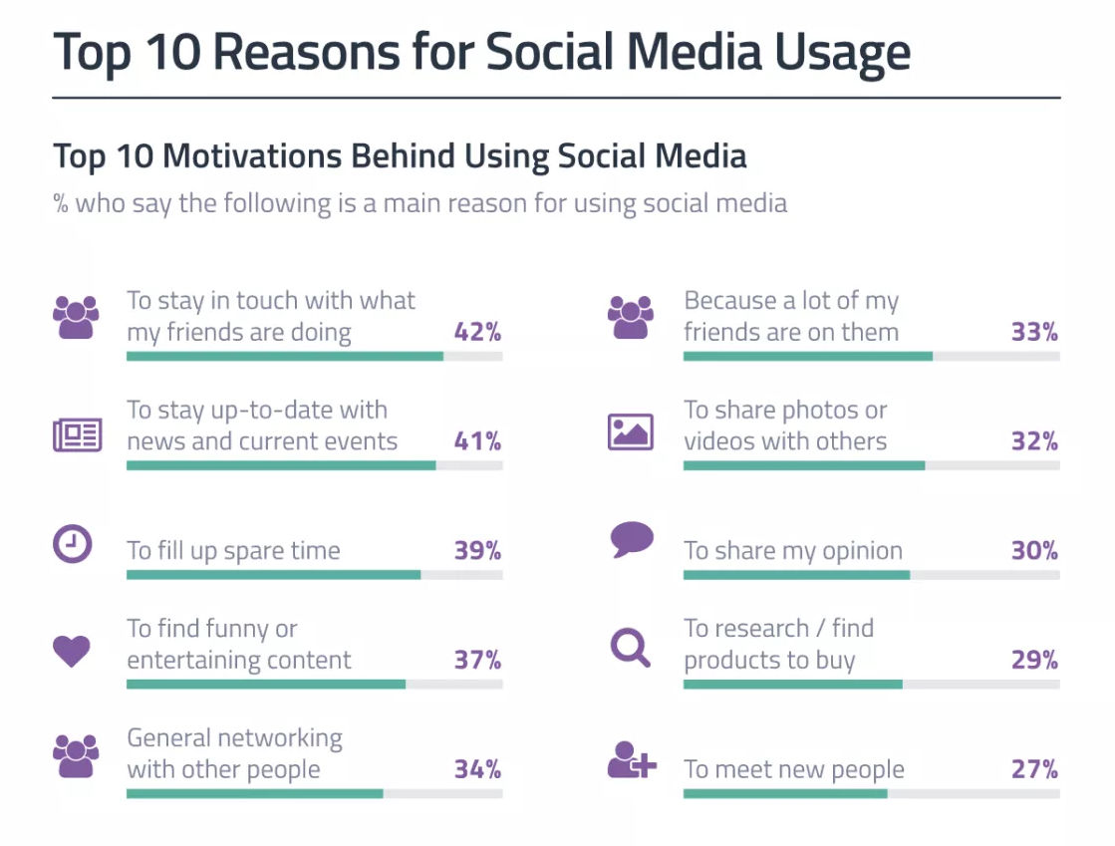

Slide 7

What are the positives of social media?
Write the positives on a sticky notes

Slide 8
Positives of social media
Easier to do good deeds
Authentic knowledge at our fingertips
Stay connected with loved ones
Be part of good initiatives
Messenger of Allahﷺ said, "Whoever guides someone to virtue will be rewarded equivalent to him who practices that good action". [Muslim].
The Messenger of Allah delivered a religious speech on the Day of Sacrifice and said: 'Let those who are present convey to those who are absent. For perhaps the one to whom it is conveyed will understand it better than the one who (first) hears it.'"

Slide 9
What are the negatives of social media?
Write the negatives on a sticky notes

Slide 10
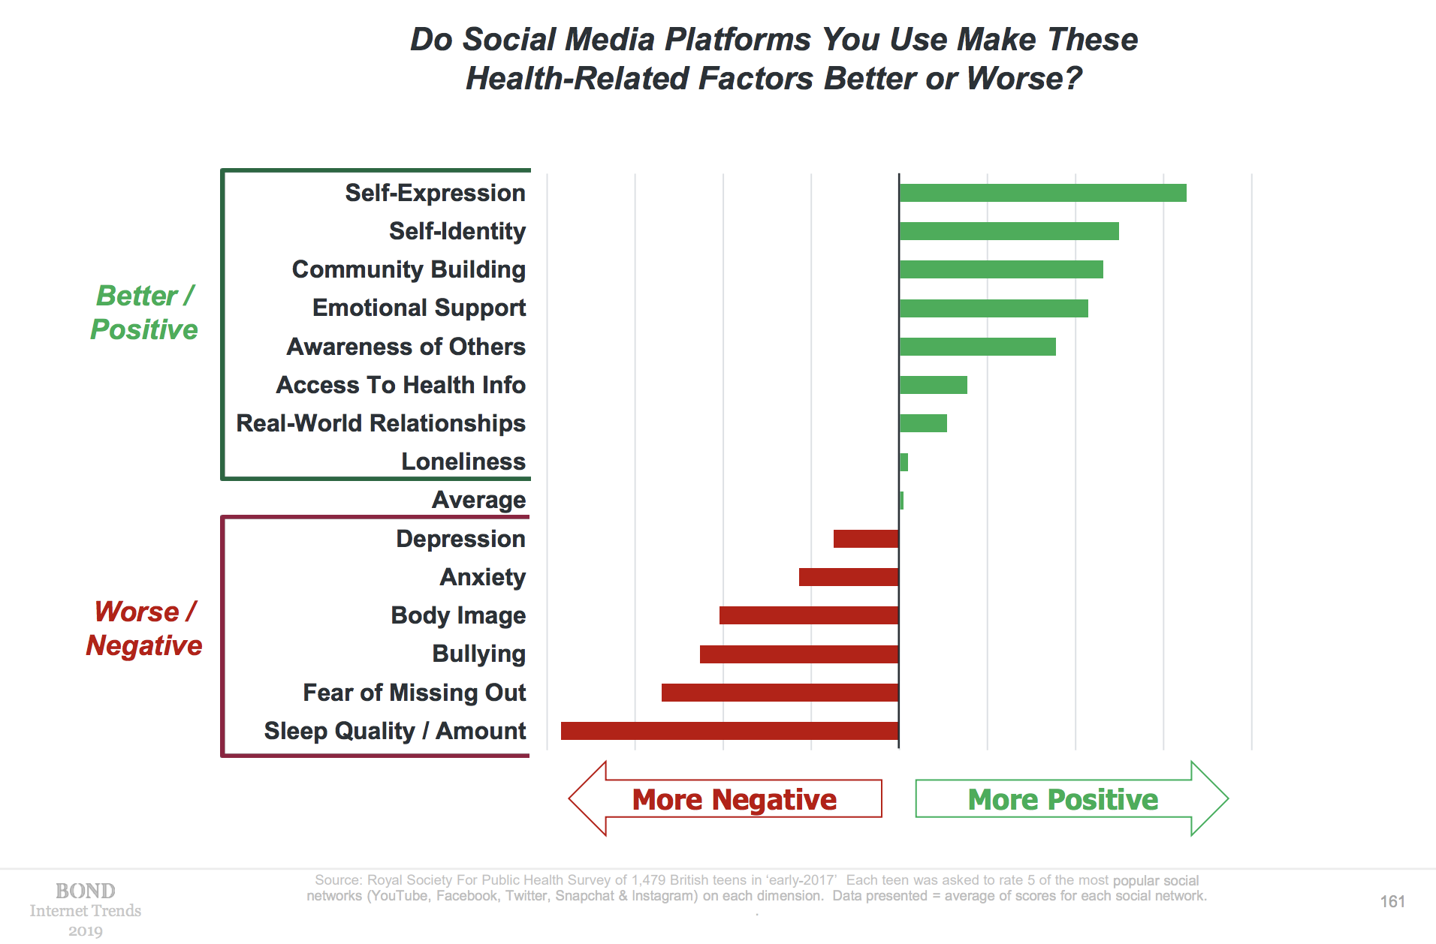

Slide 11

Unrealistic expectation –
Is it really as it seems?
We have increased our social standards
Social media plays a big part in making us feel dissatisfied with what we currently have
https://www.youtube.com/watch?v=0EFHbruKEmw

Slide 12
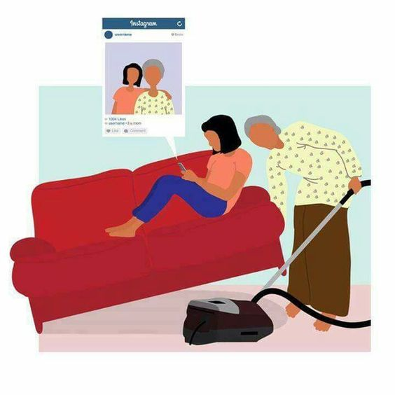
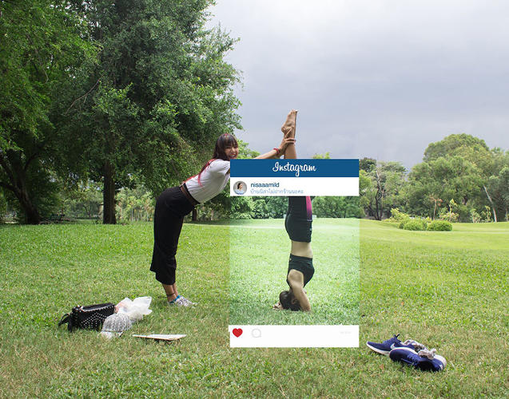


Slide 13

FOMO – Fear of missing out
FOMO is a form of anxiety that you get when you’re scared of missing out on a positive experience or emotions that someone else is getting. Actually a word in the dictionary

Slide 14
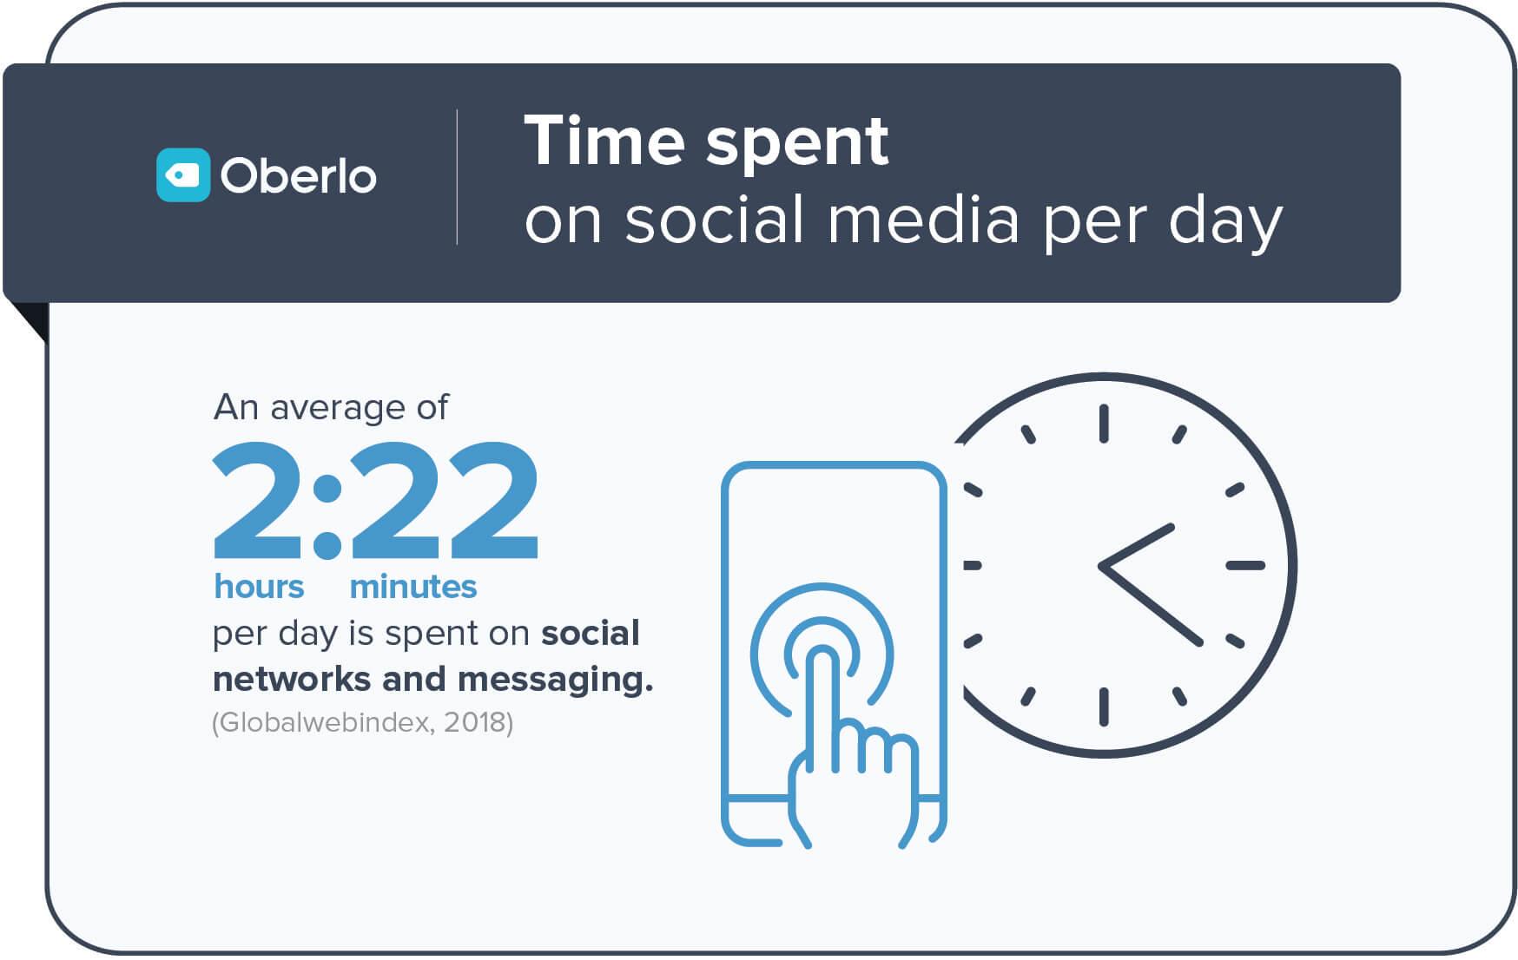

Slide 15


Time
Narrated Ibn `Abbas:
The Prophet ﷺsaid, "There are two blessings which many people lose: (They are) Health and free time for doing good."

Slide 16
Sins are highlighted on social media
Abu Hurairah (May Allah be pleased with him) reported:
Messenger of Allah ﷺ said, "Every one of my followers will be forgiven except those who expose (openly) their wrongdoings. An example of this is that of a man who commits a sin at night which Allah has covered for him, and in the morning, he would say (to people): "I committed such and such sin last night,' while Allah had kept it a secret. During the night Allah has covered it up but in the morning he tears up the cover provided by Allah Himself."
[Al-Bukhari and Muslim].

Slide 17


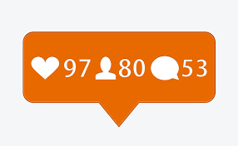

Slide 18
Chasing fame
On the authority of Abu al-’Abbas Sahl bin Sa’ad as-Sa’idee (may Allah be pleased with him) who said:
A man came to the Prophet (peace and blessings of Allah be upon him) and said, “O Messenger of Allah, direct me to an act which, if I do it, [will cause] Allah to love me and the people to love me.” So he (peace and blessings of Allah be upon him) said:
“Renounce the world and Allah will love you, and renounce what the people possess and the people will love you.” (Ibn Majah)

Slide 19

Fake news – Be critical
https://www.youtube.com/watch?v=EJDFeXomVvg

Slide 20
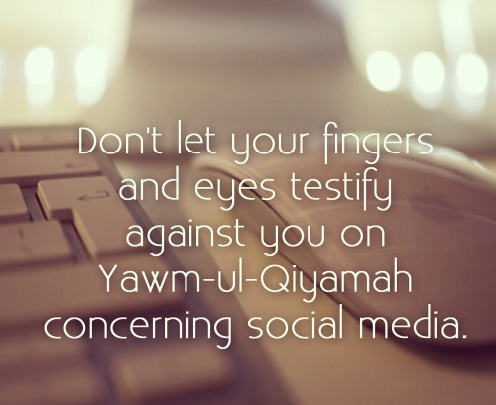
Accountable for your social media footprint
Messenger of Allah, may Allah bless him and grant him peace, said, "One of the most evil of people is the two-faced person who shows one face to these people and another face to those people."

Slide 21
Rights of social media
The Messenger of Allahﷺ said: Avoid sitting by the road side.” The people then said, ‘O Allah‘s Messenger ﷺ,we cannot do without those meeting places in which we converse” So he said, “Well, if you insist (on that) give the road its due rights.”
They asked, ‘What are the road’s due rights?’ He replied, “Lowering your gaze, abstaining from anything offensive, returning salutations, enjoining the right (Ma'ruf) and forbidding from evil deeds (Munkar).”
(Bukhari and Muslim)

Slide 22
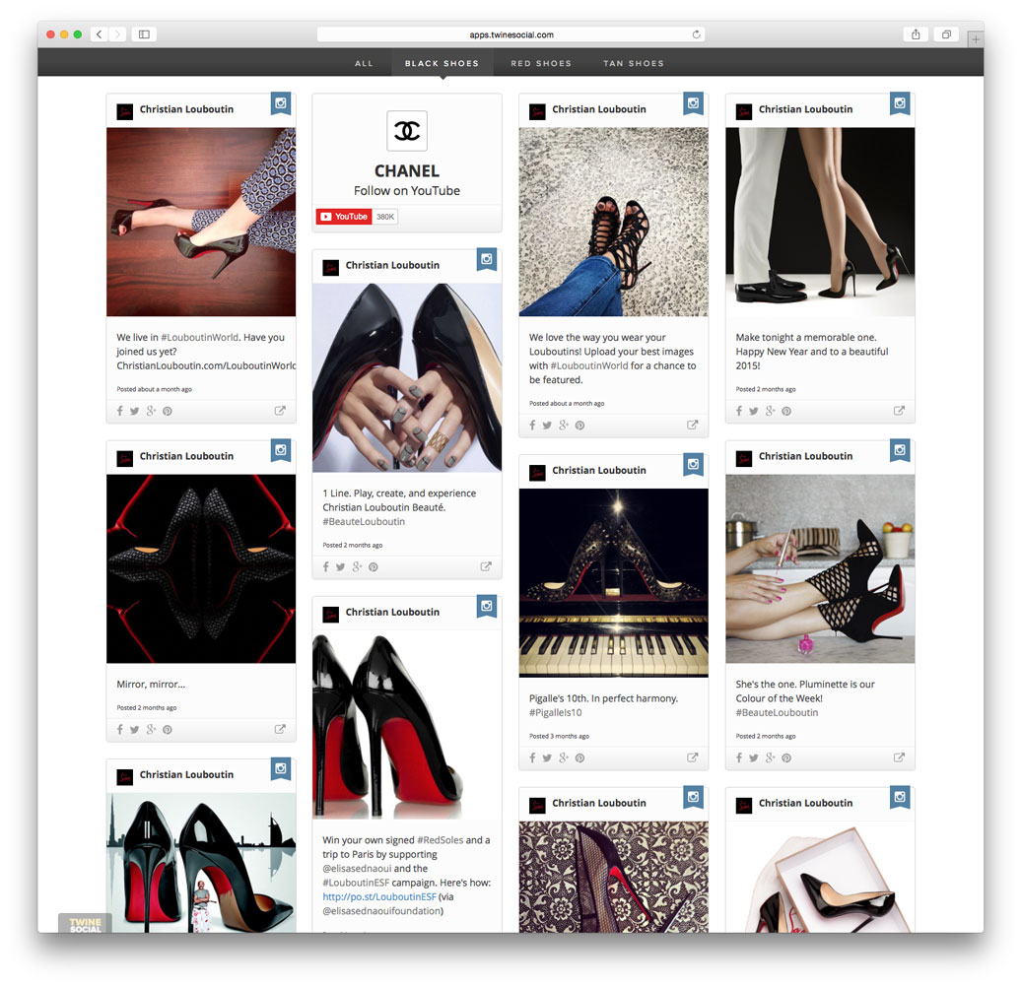
You are what you consume
What you follow
What you watch
What you see
Will dictate:
How you feel
What you want to buy
Where you want to go

Slide 23

Where do you get your Islamic knowledge from?

Slide 24
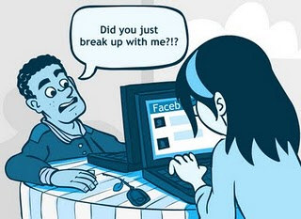
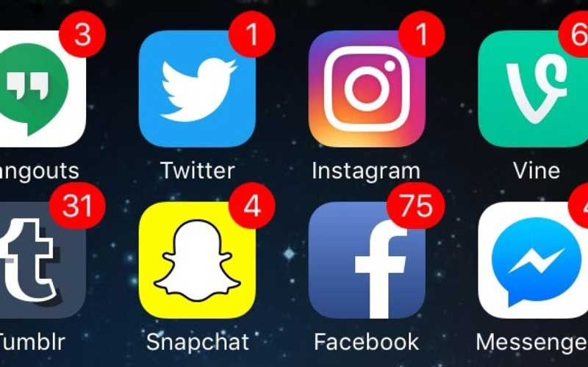
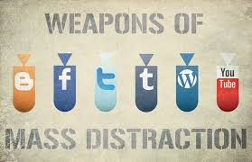
What are your limits/boundaries on social media?

Slide 25
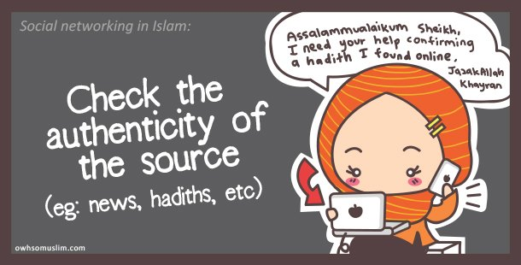
1. Verify information

Slide 26
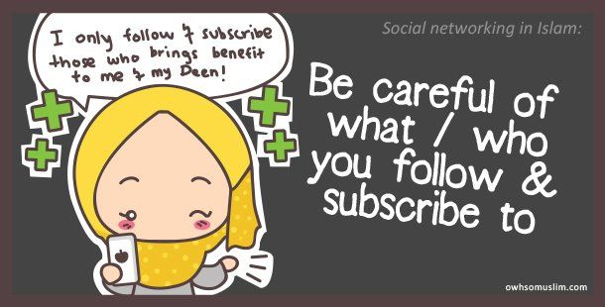
2. Who do you follow
The Prophetﷺ said: A man follows the religion of his friend; so each one should consider whom he makes his friend. (Abu Dawood)

Slide 27
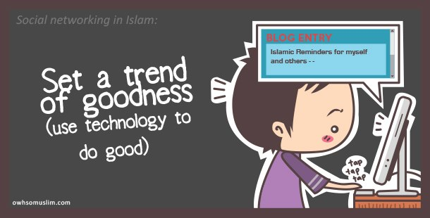
3. Be the example

Slide 28
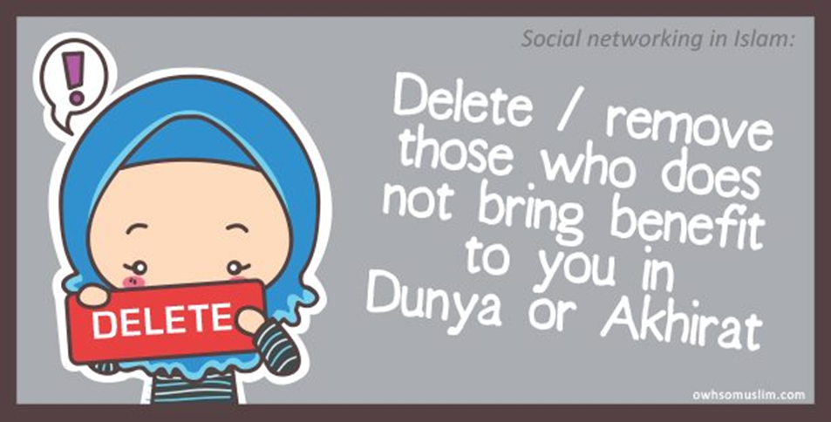
4. Social media detox

Slide 29
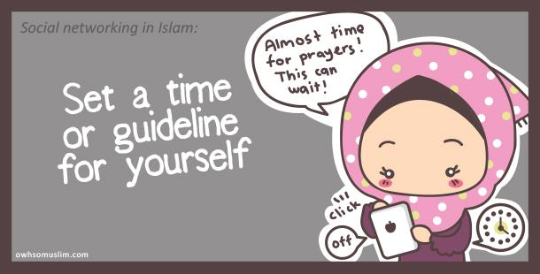
5. Time limits

Slide 30
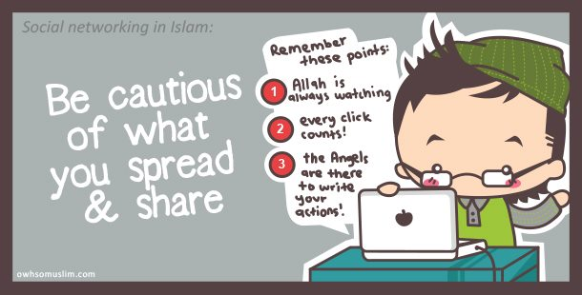
6. If you are active on social media…

Slide 31
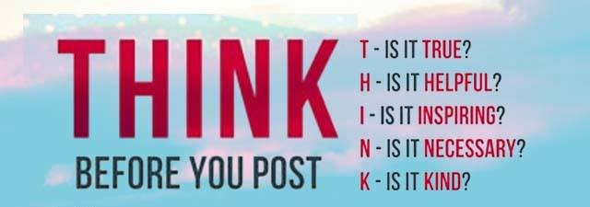

Slide 32
Closing points:
The Prophet (ﷺ) said, "He who believes in Allah and the Last Day must either speak good or remain silent.“ (Muslim)
The Prophet (ﷺ) said, "Indeed among the excellence of a person's Islam is that he leaves what does not concern him.“ (Tirmidhi)

Slide 33

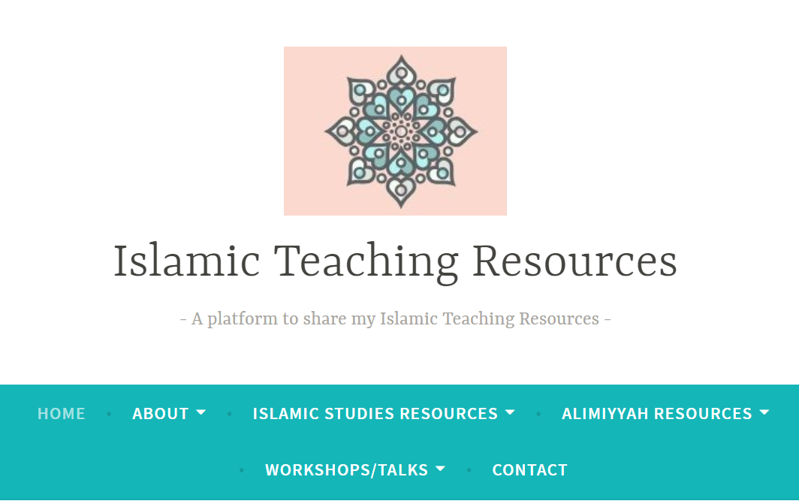
Follow up
Instagram: @sumiyyaiqbal
My blog:
https://islamicteachingresources.wordpress.com/

