Slide 1
Last 10 nights
Sumiyya Iqbal

Slide 2
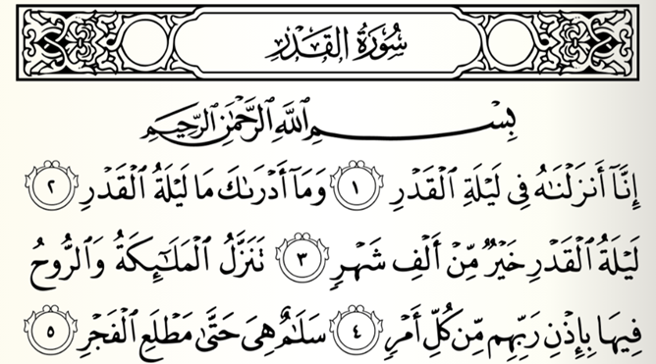

Slide 3
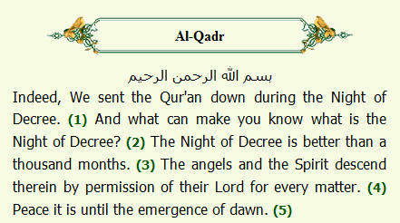

Slide 4
WHEN IS IT? If you started fasting on Monday 6th May
Night of Ramadan | Date
21st Odd night | Saturday 25th May
23rd Odd night | Monday 27th May
25th Odd night | Wednesday 29th May
27th Odd night | Friday 31st May
29th Odd night | Sunday 2nd June

Slide 5
WHAT TO DO IN IT?
Abu Hurayrah relates that the Prophet (May Allah’s peace and blessings be upon him) said: “Whoever stands (in the voluntary night prayer of) Ramadan out of faith and in the hope of reward, his previous sins will be forgiven. And whoever spends the night of Laylatul Qadr in prayer out of faith and in the hope of reward, his previous sins will be forgiven.” [Sunan an-Nasa’i]

Slide 6
Plan your day –
3 tips for the day that will lead to a productive night
Try to get a short nap in the afternoon to recharge your battery for the night.
Keep your day easy – avoid doing any task in Ramadan that can be left for after Ramadan
Keep the Iftaar simple and minimise your work in the kitchen

Slide 7
Plan your nights –
5 tips to help you maximise your last 10 nights
Plan and portion your night – Plan your sleep, your Taraweeh, your Qur’an recitation etc
Mix up various different forms of worship
Give charity every night even if it’s a pound
Keep hydrated and eat well
Plan your Du’as. What are you going to ask for? Create a Du’a list

Slide 8
