Slide 1
Surah Rahman The All – Merciful
Madani
73 verses

Slide 2
SURAH RAHMAN
Describes the spiritual and worldly bounties of Allah
verse is repeated is 31 times
Repetition is for emphasis in Surah Rahman and Surah Qalam

Slide 3
Verse 1
The name of Allah, Ar Rahman is used as the pagans of Makkah were unaware of this name of Allah and used to say what is Ar- Rahman
OR
- To indicate that Allah's bounties are a gift from Allah. He is in no way in need of us or was it upon Allah to bless us with his mercy

Slide 4
Verse 2
Greatest of all blessings is the knowledge of the Quran

Slide 5
Verse 4
Why is the creation of man mentioned after the Quran?
One can only have knowledge of the Quran, if created first?
Because the fundamental purpose of creation is to impart the knowledge of the Quran and to follow its guidance.
Express himself…
- Refers to all modes of communication

Slide 6
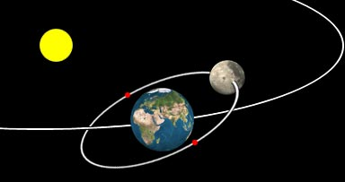
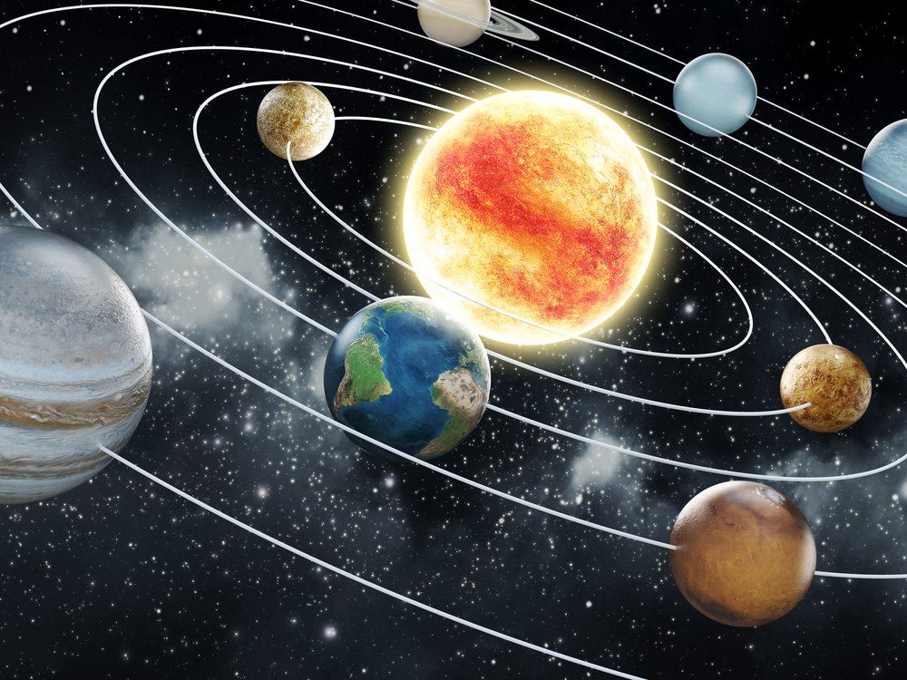
Verse 5
Why are the sun and moon specifically mentioned?
The entire system if this world depends on their movement
They are never delayed nor disturbed
There has never been an error for millions of years
controls our day and night, seasons, nights and months
Human inventions are subject to faults and breakdowns
Divine creation needs no repairs

Slide 7
Verse 6
Najm – tree with no stem
Shajar – tree with stems and branches
Natural objects have been assigned a specific task for the benefit of mankind and have no choice.
They perform their task with no deviation
Everything from the huge sun to the smallest tree obey Allah's command

Slide 8
Verse 7
Rafaa- raise up
Wadaa – to put down
Allah raised the heavens -
What other opposites does Allah mention in the Quran?

Slide 9
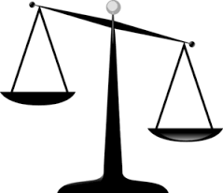
Verse 8 and 9
Justice Vs Injustice
Should not fall short in weighing

Slide 10
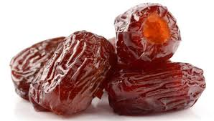
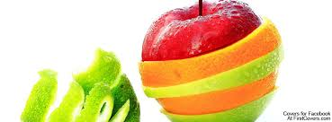
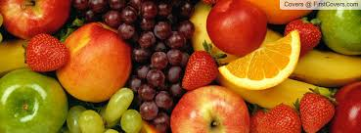
Verse 11
The cover that surrounds and protects the dates
Look at how Allah protected your foods
Until it was read for you to consume

Slide 11
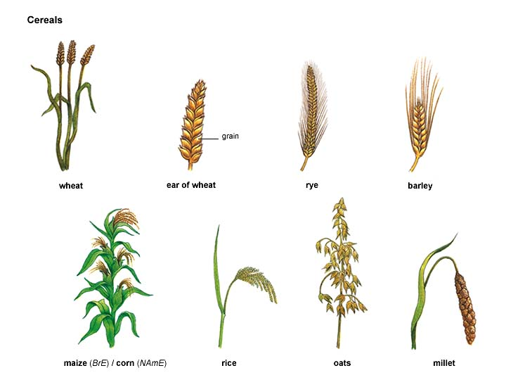
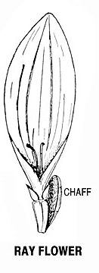
And the grain having chaff – V12

Slide 12
Verse 14 – He has created man from dry clay, ringing like pottery
Salsal – Wet soil when it becomes dry and heavy
Fakhaar – Wet soil when it is baked
Major element in the creation of jinn = Smokeless flame of fire
Major element in the creation of humans = Dry sounding clay

Slide 13

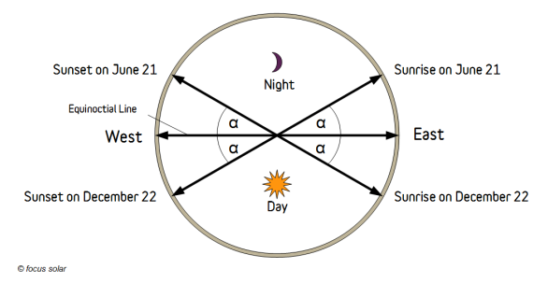
Verse 17 - He is the Lord of both points of Sunrise and Sunset
Two points of Sun rising and setting?
In the winter and summer the sun rises from two different points and sets at two different points
Two easts and two wests

Slide 14
Verse 19 – Two seas that meet together
Sweet and Salty waters
There is a barrier they do not transgress
Due to the difference in salt and density
Mediterranean and Atlantic is one example
https://www.youtube.com/watch?v=oUAQy14g0Qc
https://www.youtube.com/watch?v=T1ua9iBRWQU

Slide 15
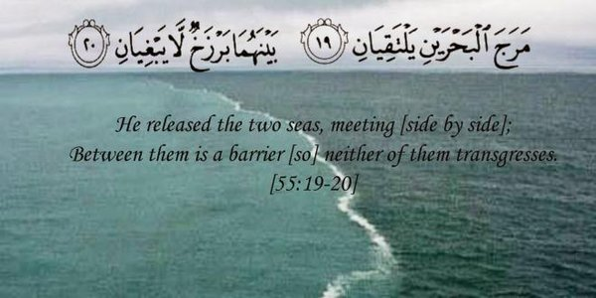

Slide 16
Verse 22 – from both of them come forth the pearl and coral
It is known that the pearls and corals are found in the salty waters
The Quran tells us that they are found in both
How?
They originate from the sweet waters where it is not easy to hunt for them, however the sweet water deposits and carries the pearls and corals into the salty waters, where they are usually extracted from.

Slide 17
Verse 24 – And His are the sailing ships raised up in the sea like mountains
How does a ship balance on water?
Why does it not sink?
Research and show?
Add images

Slide 18
Verse 27 -
The word Wajh(face) refers to the being of Allah
Everything will perish but Allah

Slide 19
Verse 29
Everyone is in need of Allah, willingly or unwillingly
In this world you need – Food, health, welfare and sustenance
In the hereafter you will need – Forgiveness, mercy and paradise
Every one has needs at every moment and only Allah can fulfil everyone's needs at the same time

