Slide 1
Surah Qamar
The moon
Makki surah – 55 verses

Slide 2
Section 1 – Verse 1-8
The day of Judgement

Slide 3
The hour has drawn near, and the moon has been split asunder (1)
This surah opens with the same theme of the last verse of the last surah
One of the signs of the last day is the coming of Prophet Muhammad and the splitting of the moon
Just like Allah’s power split the moon into two, the planets and stars will be destroyed by him into small pieces, which is thought not to be possible

Slide 4
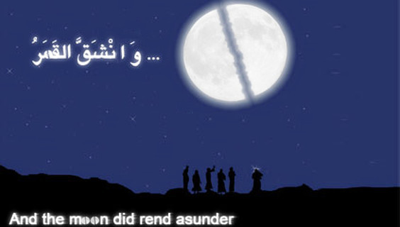
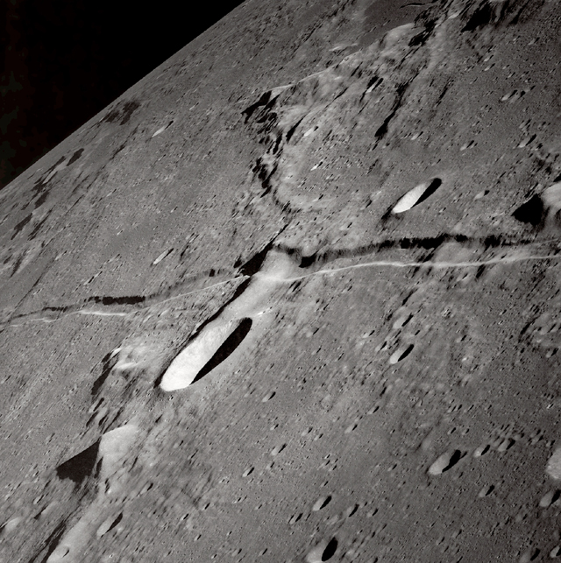
The moon splitting
The disbelievers of Makkah asked for proof, when they were at Mina
Moon was split into two parts
There was a mount Hira between the two parts of the moon
The people with Prophet Muhamaad claimed that this is just sorcery, he cannot deceive the world.
They waiting for people from outside the town to come in and they did confirm they saw the moon in two parts.

Slide 5
V3 – every matter has to be settled
Istiqrar – to settle
Everything must reach and end
All matters must become clear
False will be removed
And truth will prevail
Referring to Day of Judgement

Slide 6
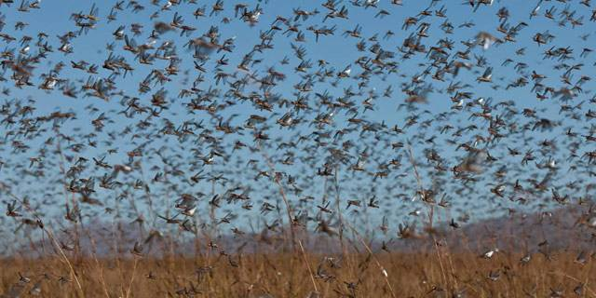
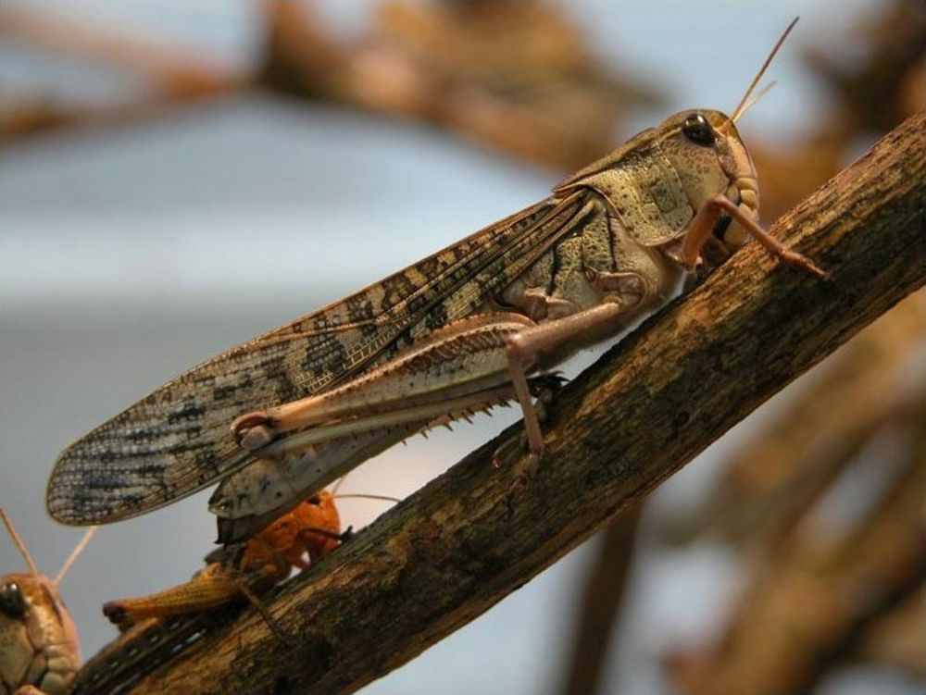
V8 – Rushing quickly towards the caller
Muhtieen – walking quickly with ones head raised above
Graphic image of Day of Judgement
People will be coming out of unmarked graves like locusts spreading

Slide 7
Section 2 – Verse 9-17
The story of the people of Nuh(as)

Slide 8
The people of Nuh(as)
For 950 years:
- They threatened him
- Warned him that if you do not stop preaching, you will be stoned to death
- They would choke him
- He prayed for their forgiveness and understanding
- When the situation become intolerable he made dua to Allah to help him against them
- Allah sent down a torrential rain, and they drowned

Slide 9

V12 – Water of both kinds
Rain from the skies
And bubbling water gushing from the ground
Huge flood
No refuge even at the highest point
Captain of the ship is Allah

Slide 10
V17- We have made the Quran easy
Ease in understanding
Layman and intellectual can benefit from it
Young or old can benefit from it
Ability to memorize the full Qur’an (previous nations could not)
Repeating verse in this surah

Slide 11
Mudhakir
Dhikr – to remember
Dhaakir – one who remembers
Mudhakir – One who puts the effort in to remember
Even the original word is mudtakir – with thaa so hard to say, so it has been made easier to say with two dhaals, mudhakir.
Less effort to say, therefore less effort to do
The purpose of your learning Quran, memorisation, your grammer lessons all to seek advice from the Quran

Slide 12
Section 3 – Verse 18-22
The people of Aad

Slide 13
Section 4 – Verse 23-32
The people of Thamud

Slide 14
Section 5 – Verse 33-40
The people of Lut -

Slide 15
Section 6 – Verse 41-42
The family of Firawn

Slide 16

Five nations mentioned
Nuh
Aad
Thamud
Lut
Musa
The most strongest and resourceful nations
These verses show you how even the superpowers were destroyed by Allah
Same verse is repeated in the Surah to advise the Muslims, the only way ro avoid the punishment is to take the advice of the Quran.

Slide 17
Section 7 – Verse 43-55
Back to the People of Prophet Muhammad

Slide 18

VERSE 49 – We have created everything according to predestination
Everything is created with its proper measure and proportion
Human body, every limb in everyone is so different
Allah knows everything before it will occur
Allahs command will happen in the blink of an eye, big or small

Slide 19
Verse 54-55
The God fearing will be in gardens and in a special river. Not Anhaar but nahar – a specific river
Maqadh – a seat you would sit in for a long time. Why would you want to sit in Jannah somewhere for a long period of time?
Because you will be near Allah, the most high!!!!

Slide 20
Surah ends very positively
At this time, the sahabahs were going through a lot of hardship just because they have become Muslims
These verses what the companions would hold on to
Makkan Quran – You don’t see the world the way you did before
Aim – to change your perspective to life

Slide 21
Quick quiz

