Slide 1
Surah Najm
The star

Slide 2
Background of the surah
First chapter proclaimed in Makkah
First Surah revealed with a verse of sajdah in it
When the Prophet (May Allah’s peace and blessings be upon him) recited it and prostrated
Everyone prostrated behind him, even the disbelievers
One of the very early surahs

Slide 3
Section 1 - The oath
Verse 1 – 4

Slide 4
Verse 1 – “By the star when it goes down to set”
Najm is in this surah, refers to thurayya – a loose cluster of hundreds of stars
Hawa – means to fall or plunge. When stars fall they set
Why has Allah sworn a oath by stars?
Arabs used to use the stars to guide their travels in the sandy desserts of Arabia, so now they will be led to the goal and to the end of their spiritual journey by the star - Prophet Muhammad

Slide 5
Verse 2 – subject for which the oath was taken
An answer to their allegations in the previous surah
The path that the prophet is guiding towards is the right path leading to Allah's pleasure
He is not deviated

Slide 6
Why does it say “Your companion”
Prophet (May Allah’s peace and blessimgs be upon him) is not an outsider
He is not a stranger
He is from amongst you
He is from the Quraysh
He was born amongst you, grew up among you and has lived amongst you his whole lifetime
You called him ‘Al Amin’ – The trust worthy one
He never told a lie against a man, how could he lie against Allah

Slide 7
Verse 3 – He does not utter anything of his own desire
Quran – Words of Allah
Hadith – meaning inspired by Allah, but words of Prophet (May Allah’s peace and blessings be upon him)

Slide 8
Section 2 - The revelation
Verse 4 – 18

Slide 9
Verse 4 – 18
1 – Refers to incident during Miraaj – The Prophet seeing Allah
2 – Refers to when Prophet (May Allah’s peace and blessings be upon him) saw angel Jibrail in his original shape
Second interpretation has more support as the incident of the Miraaj happened after this surah was revealed and the hadith of Prophet (May Allah’s peace and blessings be upon him) interpretates these verses saying they relate to seeing the angel Jibrail. Also the opinion of Ibn Katheer.

Slide 10
Seeing Jibrail (As)
Prophet (May Allah’s peace and blessings be upon him) saw angel Jibrail twice in his real form
He covered the entire horizon between sky and the earth
Jibrail (as) had 600 wingsa
The first time = when Jibrail (as) came to reveal prophethood and the first verses of the Quran.
The second time = On the night of Miraj near Sidratul Muntaha (Lote tree)

Slide 11
Verse 6 -
Mirrah – Strength – quality of Jibrail (as)
Strong, mighty, firm, powerful
Devil cannot intercept the angel carrying the divine revelation
Istawa – to become straight or level
When the angel Jibrail (as) was descending from the heaven, he sat on the highest part of the horizon
Angel Jibrail (as) sat on the highest part of the horizon so he could clearly be seen, on the lowest part of the horizon is level to the earth is normally hidden from the sight.

Slide 12
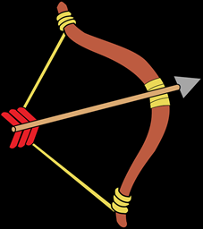
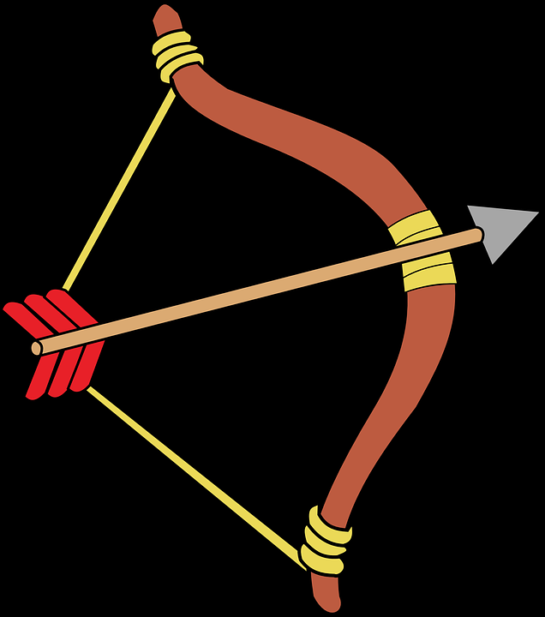
Verse 9
Qaab – distance between the curved handle of a bow and the tight chord that releases the arrow = 1 hand span
This expression is based on an Arab custom that when two people pledged themselves to a firm friendship each one of them would turn the wooden part of their bows towards themselves, but the cord part towards each other.
The cords of their bows would join together, this was their proclamation of love and affinity.
Aw adhna – was no ordinary closeness, more intimate than you can believe
The revelation was from Allah, word by word and the Angel Jibrail was bringing down in the exact same manner to the Prophet (May Allah’s peace and blessings be upon him) with no suspicion from the devils. Complete accuracy

Slide 13
Verse 11 – whatever the eyes saw the heart did not err in grasping
1. The Prophet (May Allah’s peace and blessings be upon him) heart saw Allah
2. Prophet (May Allah’s peace and blessings be upon him) saw angel Jibrail (as) in his real form

Slide 14
Verse 13 – Jibrail (as) seen the second time
When the Prophet (May Allah’s peace and blessings be upon him) went to Miraaj
On the seventh heaven, below Allahs throne there is a lote tree.
The access of the angels ends at this point

Slide 15
Verse 16 – The lote tree was covered by that which covered it
Abdullah bin Masud said: “Golden butterflies were at that time falling on sidra Tul Muntaha from all sides, and it seemed as if it was specially decorated for that occasion in honour of the most reserved guest, Prophet (May Allah’s peace and blessings be upon him) . ” (Sahih Muslim)

Slide 16
Verse 17 – his sight neither went wrong nor exceeded the limit
Whatever the Prophet (May Allah’s peace and blessings be upon him) saw, his eyes did not wrong him
If we see something beautiful, we may exaggerate it at times, or miss the actual thing of beauty as it is adorned so heavily but Allah negates these two factors by saying
1 – zagaa – He did not look astray, his sight did not swerve away. He did see exactly what he was intended to see
2 Ta’gaa – he did not look at other things other than what he was supposed to see
Notes:
If the prophet did not recgonize or see Jibrail (As) there would be doubt in the revelation

Slide 17
Section 3 - Rebuking the Makkan Pagans
Verse 19 – 28

Slide 18
Verse 19 – 28
Without any proof you are worshipping these idols of wood and stone
You should be adoring your mighty and powerful lord
Three most popular idols:
Lat – idol of the tribe of Thaqif
Uzza – Idol of the Quraysh
Manaat – Idol of Banu Hilal
They built houses for their idols to resemble the Kabah

Slide 19
Verse 28
Zann – baseless thoughts
Baseless thoughts were the cause of idolatry
Opposite of Yaqeen – definitive knowledge about something that does exist

Slide 20
Section 4
Verse 29 – 31

Slide 21
Section 3 – Verse 29 – 32

Slide 22
Verse 29 – turn away from him who turns away from our advice
Two groups of good doers:
Group 1 – those who follow Allahs path and do good deeds – V30
Group 2 – Those who do avoid major sins and shameful acts except minor involvement – V32

Slide 23
lamaam
إِلاَّ اللَّمَمَ
1. Refers to small faults and minor errors
Allah says in the Quran: “If you abstain from the major sins out of what you have been forbidden from, we shall write off your minor sins ” (Surah Nisa – V 31)
2. Refers to a sin a person commits incidentally and then repents and never returns to it. If a major sin is committed and repents he will not be excluded from the god fearing.
Allah says in the Quran: “And those who, when they happen to commit a shameful act or wrong themselves, remember Allah then, seek forgiveness for their sins – and who is there to forgive sins except Allah? And so not persist in what they have done knowingly” (Surah Al Imran – V 135)
If a person persists in a minor sin and it becomes a habit it will turn in to a major sin

Slide 24
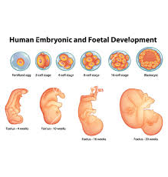
V 32 – He created you from the earth and when you were embryos in the womb of your mothers
Man does not have knowledge of himself as much as Allah knows him
Man has no recollection of all these stages
The ultimate source of his achievement is Allah.
Any good man does is not him own accomplishment
Zainab bin Abi Salmah was named as Barrah (righteous) and the Prophet suggested her names should be changed.
“Do not claim purity for yourselves ”
(52:32)

Slide 25
Section 5 - Teachings from the scriptures of Musa and Ibrahim (as)
Verse 33 – 55

Slide 26
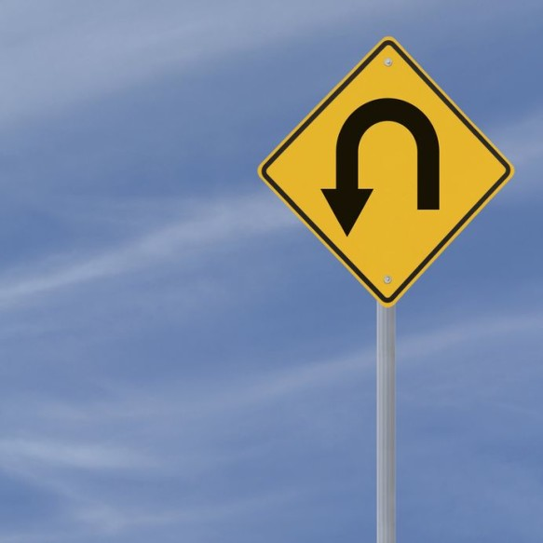
Verse 33 – Did you see the one who turned away
Walid ibn Mughirah accepted Islam
One of this friends rebuked him for leaving the religion of his forefathers
He replied I fear Allah's punishment
His friend said pay me some money and I will take upon myself your punishment
His friend asked for more money, he paid it and they wrote up a document and signed it
He left Islam

Slide 27
Verse 35- Does he have knowledge of the unseen
Referring to the friend who said he will take his burden of punishment on his behalf
He does not know that every person is accountable for their own deeds

Slide 28
Verse 37 – In the scripture of Musa and ibrahim
Ibrahim (as) title – Wafaa
He fulfilled the covenant With Allah that he will obey him and convey his message to all people.
Allah made him pass through severe trials and tribulations
The Prophet (May Allah’s peace and blessings be upon him) asked ‘Do you know the meaning of wafaa? Abu Umamah replied: ‘Allah and his messenger know best the Prophet (May Allah’s peace and blessings be upon him) ’said: “He fulfilled the days work by starting it with the performance of 4 rakahs (salatul Duha)”
The Prophet (May Allah’s peace and blessings be upon him) said: ‘Perform 4 rakahs in the early part of your day, I shall take care of your affairs till the end of the day’

Slide 29
The Prophet (May Allah’s peace and blessings be upon him) said: Do you know why Allah gave Ibrahim (As) the title of Wafaa? Then he said because he used to recite the following dhikr every morning and evening
فَسُبْحَنَ اللّٰهِ حِيْنَ تُمْسُوْنَ وَ حِيْنَ تُصْبِحُوْنَ وَ لَهُ الْحَمْدُ فِىْ السَّمَوَتِ وَ الۡاَرْضِ وَ عَشِيًّا وَّ حِيْنَ تُظۡهِرُونَ

Slide 30
Verse 38 + 39 -
No person shall carry the burden of anyone else's sin
You will only benefit from the good you have done yourself
The above two rules, were in the shariat of all prophets
However these two prophets are specifically mentioned as people of their time had a horrid custom that they would kill the son instead of the father, brother or sister or some other family member would be killed instead of the son etc.

Slide 31
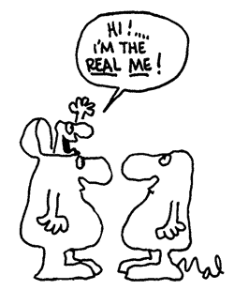
Verse 40
Outer actions are not enough, Allah will take into account the real inner motive behind the actions
the Prophet (May Allah’s peace and blessings be upon him) said: “Actions shall be judged by the intentions ”
All actions should be performed only for the sake of Allah, with pure sincerity.

Slide 32
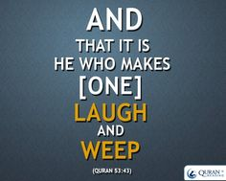
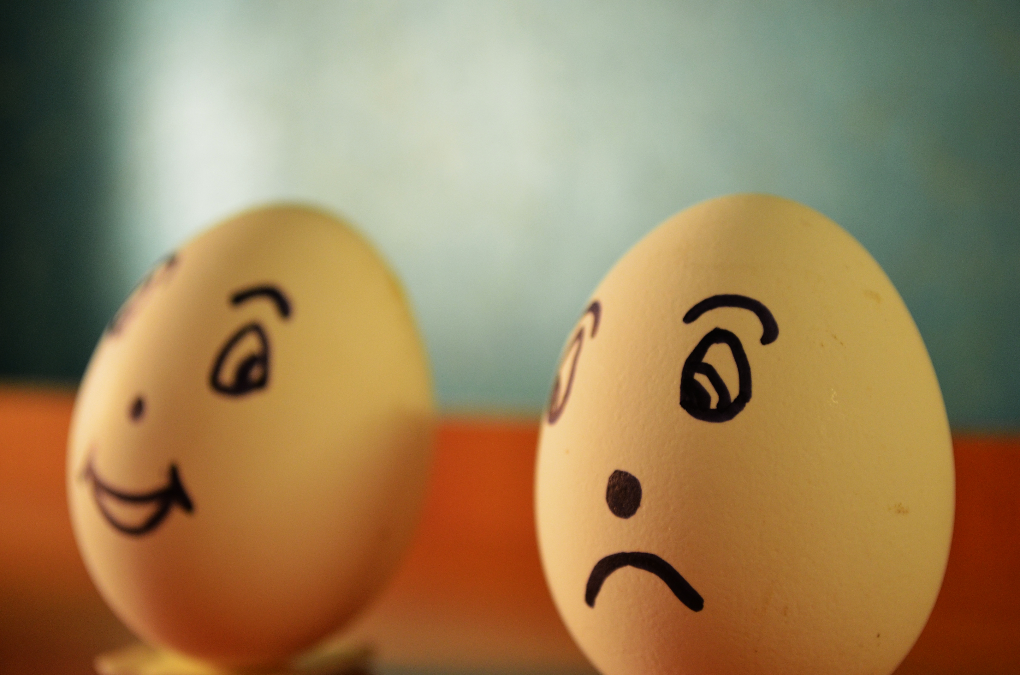
Verse 43
The primary cause of our happiness and sadness is Allah
All secondary causes are created by Allah
He can make your laugh at any time, and make you weep at any time

Slide 33

Verse 49 - Sirius
Sirus is a name of a star
Some Arab tribes worshipped the mighty star, Sirius, because they regarded it as a source of good or bad luck.
Allah mentions this star to refute this notion
To affirm that he is the Lord and master of even this star

Slide 34
Verse 50
Aad – The strongest and rebellious people against Allah
Hud was sent to the nation of Aad
Allah destroyed the nation by a fierce wind
Prophet Salih was sent to the nation of Thamud
Destroyed by a loud noise which burst their hearts open
People of Lut
Allah destroyed them by over turning their towns

Slide 35
Verse 55
Which of your lords bounties will you dispute
This verse is addressed to every human being
So many signs in this surah and in the previous scriptures
How long will you continue to deny the truth?

Slide 36
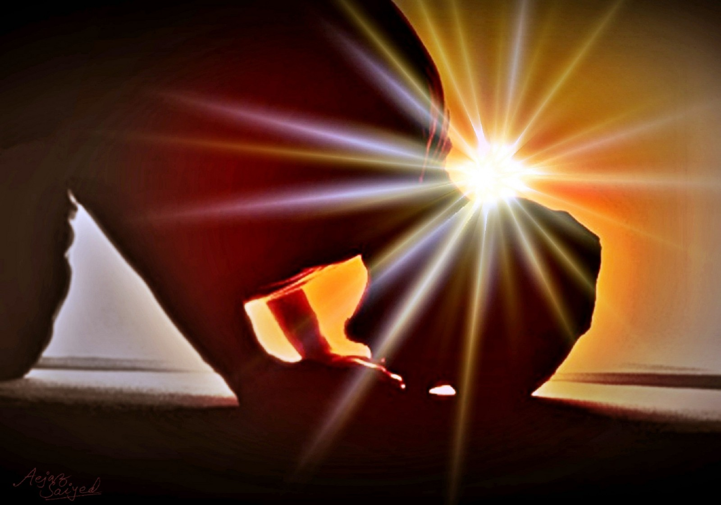
Verse 59 - 62
Will you just laugh at it
Not weep at your sins or shortcomings
The Quran – divine discourse has come to you
You are headless?
Busy in vain play, pointless activities
All this should be a lesson for anyone who considers them seriously, he should worship Allah and bow down before him in humbleness

