Slide 1
Surah At- Tur
(The Mount)
Makkan surah – 49 Verses

Slide 2
Verse 1 - Tur
1st Oath - The mountain Allah spoke to Musa (as)
Tur – in Hebrew means a mountain that has trees
Refers to Mount Sinai in Madyan
Qurtubi – Four mountains of Jannah in this world and Tur is one of them
Significance and honour of this mountain

Slide 3
Verse 2 – by a book, written on an unrolled scroll
2nd oath –
Fine parchment – soft papers
Quran and Tawrah was verbally delivered

Slide 4
Verse 3 - Bait ul Ma’mur
3rd oath –
Heaven made for the angels
Parallel to the Ka’bah on the earth
70,000 angels visit it each day and never come out

Slide 5
4th Oath – by the roof raised high

Slide 6
Verse 4 - Sea filled up with fire
5th oath –
The sea will become a raging fire on the Day of Judgement.
Surrounding people on the plain of Hashr
A Jew asked Ali (ra) where us Hell? He replied: “the sea” (Qurtubi)
Sea tries to overthrow the earth 3 times a night, but Allah does not allow it

Slide 7
Verse 7 – The punishment of your Lord is sure to fall
All 5 oaths are testifying this fact
Jawab ul Qasm
Assuring that the punishment of Allah will come to pass and none will be able to avert from it

Slide 8
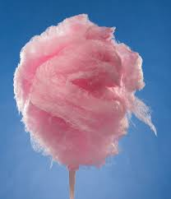
Mountains – will smash on to the earth in pieces and like dust will fly away into the sky. No sign of them will be left
No need for them anymore that the humans have left the Earth

Slide 9
The companions and Surah Tur
Once Umar (ra) recited Surah Tur and after a sigh and fell ill for about 20 days. People would visit him not knowing what caused his illness (Ibn Kathir)
Jubair bin Mutim (ra) once heard Prophet Muhammad (May Allah's peace and blessings be upon him) recite this Surah in Maghrib Salah and when he heard Verse 7 and 8 he though his heart would burst with fear and he accepted Islam. He felt that he would not be able to move unless the torment would descend on him. (Qurtubi)

Slide 10

Verse 21 – Levels of Jannah
Parents increasing children's ranks - Prophet Muhammad (May Allah's peace and blessings be upon him) said: When a person enters Paradise, he will enquire about his parents, wife and children (as to where they are). He will be told that they have not attained your grade (Their place is elsewhere is Jannah). The person will say: “Oh Allah! I had not worked only for myself but for all of them.” Allah will command that they all be kept together with him in the same rank in Paradise
(Ibn Kathir )

Slide 11
Verse 21 – Levels of Jannah
Children increasing parents' ranks - Prophet Muhammad (May Allah’s peace and blessings be upon him) said: Verily, Allah shall elevate the grade of a righteous servant in Paradise, who will ask: “Oh Lord! How did I earn this? Allah will reply: “Through you sons invoking me to forgive you”
(Muslim)

Slide 12
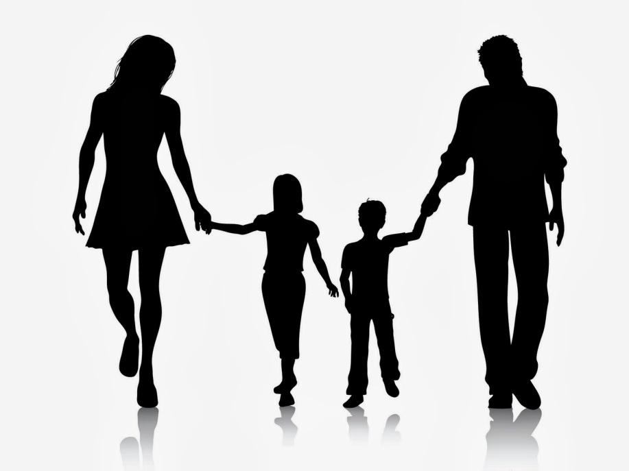
Verse 21 – For every person will be pledged for what he earned
Allah is fair
He will not punish some one for the sins of others
Every one is responsible for their own actions
If your children committed sins they will not be on your load
If your parents committed sins they will not be on your load

Slide 13
Verse 48
“You are before our eyes ” – you are in our protection, do not be anxious
What is the true cure to all calamities, tests and times of hardships.....???

Slide 14
“And proclaim the purity of your Lord along with his praise when you stand (in prayer) ”
Two opinions:
Standing in front of Allah in prayer
Standing in front of people when finishing a gathering

Slide 15
Standing up from your bed for prayer
Ibn Jarir - Could also mean standing from your sleep. The prophet Muhammad said: “Whoever gets up at night and recites
La illlaha ilallah wahdahu la shareekha lahul mulku wa lahul hamdu wa huwa ala kuli shai in qadeer. Subhanallahi wal hamdulillahi wa laa ilaha illa lahu wallahu akbar wa la hawla quwata illa billah”
Then if he intends to pray and performs wudhu and the prayer, his prayer will be accepted. (Ibn Kathir)

Slide 16
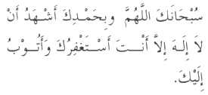
Standing from a gathering
After any gathering you should say:
Subhanak Allahuma wa bihamdik
I proclaim your purity, o Allah, along with your praise.
The Prophet Muhammad (May Allahs peace and blessings be upon him) said: “Whoever sits in a gatherings in which he speaks idle excessively but before he stands up to depart that gathering he says the below dua Allah will forgive him for what he said in that gathering.”

Slide 17
Find the themes in the Surah Ad – Dariyat and Surah Tur and highlight the similarities or differences between the two surahs
 | Similarities | Differences
Surah Tur
Surah Ad – Dariyaat

Slide 18
Similar themes
Surah Tur | Surah Adh -Dhariyaat
Swearing oaths | Swearing oaths
Attitude of disbelievers to prophet | Attitude of disbelievers to prophet
Warn about the punishment to come | Warn about the punishment to come
Blessings | Blessings
Hereafter | Hereafter

