Slide 1
Surah Al – Waqiah
The Imminent Event
Makkah
96 Verses

Slide 2
Background of Surah Waqiyah
It is narrated from Ibn Katheer: Abdullah ibn Mas’ud, May Allah be pleased with him was suffering from great illness and that was his final moments, mean while Amirul Mu’min Uthman Ghani Radhi Allahu anhu was there to give him a visit. There conversation went like:
Uthman radhi Allahu anhu: what is your illness?
Abdullah Ibn Mas’ud, May Allah be pleased with him: My sins are all the root cause of my pain {illness}.
Uthman radhi Allahu anhu: what is your desire {final desire}?
Abdullah Ibn Mas’ud, May Allah be pleased with him: I seek the mercy and blessings of my Lord, Allah azza wa jal.
Uthman radhi Allahu anhu: may I call a doctor for you?
Abdullah Ibn Mas’ud, May Allah be pleased with him: the doctors have made me ill.
Uthman radhi Allahu anhu: may I send some gift from the Baitul Maal, the government stock?
Abdullah Ibn Mas’ud, May Allah be pleased with him: thank you, no need.
Uthman radhi Allahu anhu: but please let me do that for you. These might help your daughters after you {your death}.
Abdullah Ibn Mas’ud, May Allah be pleased with him: Do you think that after my death my daughters going to face poverty and hunger? I don’t think so, because I’ve strictly instructed my daughters to recite Sura Waqiah every night.
I’ve heard, Prophet salla Allahu alaihi wa sallam saying: one who will recite surah Waqiah every night, will never be needy/poor.

Slide 3
Section 1
Verse 1 – 15
Sets the Scene and mentions the three categories of people

Slide 4
Waqiyah – A name of the Day of Judgement
Waqiyah – imminent event
No doubt in this day
It is real
It will surely come to pass

Slide 5
Verse 3 – It will be abasing some and exalting others
This event will bring a great revolution
The high and mighty will be laid low
The down trodden will be exalted
The poor become rich
The rich will become poor

Slide 6
You will divided into 3 categories
Righteous
Right side of Allah’s throne
The inmates of Paradise
Disbelievers
Left side of Allah’s throne
They will be given their deeds in their left hand
The Elite
The Sabiqoon – The foremost
These are the people brought forth from the right side of Adam (as)
They will be given deeds in their right hands
These are the people brought forth from the left side of Adam(as)
The are the inhabitants of the fire
Al-Muqaraabun – The fortunate believers who have a special closeness to Allah
They will be placed infront of Allah’s throne
Include the messengers, prophets, sidiqeen, martyrs and the friends of Allah
They are fewer than those on the right hand side

Slide 7
Verse 10 – Sabiqoon
Those who accept the truth when it is presented to them
When they are asked from the rights due from them they fulfil them
They judge others matters as they would judge for themselves
Mujahid = Refers to prophets
Ibn Sirin = Refers to the early muslims who performed their prayers facing both Qiblahs
Hassan and Qatada – In every nation there will be a sabiqoon
Other say it is those who go first to the mosque
Ibn Kathir – they are all correct as they must have been first and foremost in the dunya in respect to their religion to be the first in the hereafter

Slide 8
Verse 13-14 – first interpretation
Earlier generations
- All the creation of Allah from Adam(as) till just before Prophet Muhammad (May Allah’s peace and blessings be upon him)
Later generations
- All the creation of Allah from the time of Prophet Muhammad (May Allah’s peace and blessings be upon him) till the Day of Judgement

Slide 9
The companions found verse 13 and 14 to be painful as this meant that there would be more in Jannah from previous nations
Allah revealed verse 39 and 40
Half of the inmates of Jannah will be the followers of Prophet Muhammad (May Allah’s peace and blessings be upon him)

Slide 10
Verse 13-14 – second interpretation
Earlier generations
- The companions of Muhammad (May Allah’s peace and blessings be upon him)
Later generations
- All the creation of Allah from after the companions of Prophet Muhammad (May Allah’s peace and blessings be upon him) till the Day of Judgement

Slide 11
Section 2
Verse 15 – 26
The reward of Sabiqoon

Slide 12
Reward of As Sabiqoon
Sitting on thrones woven in Gold fabric
Served by the servent youth of Paradise (who never get old and were born in Paradise
Drink wine which will give no headache nor intoxicated
Meat of birds of their choice
Houris with big eyes
They will hear no absurd talk

Slide 13
Section 3
Verse 27 – 40
The reward of the people on the right

Slide 14
Reward of those of the right
Righteous believers and sinful disbelievers (who either due to the grace of Allah or the intercession of Prophet or friend of Allah)
Lote tree with no thorns
Banana trees, with fruits piled on top of each other
Shade spread all over
Lots of fruit, which will never run out of any season, nor need a caretaker to looks after the gardens and will stop you from picking the fruits
Mattresses of high quality
Women from the world will be recreated as beautiful women at the age of 31 yrs old

Slide 15
Section 4
Verse 41 – 56
The reward of The people on the left

Slide 16
The people on the left
In burning wind and boiling water
Shade of black smoke
Neither cool nor graceful
They will have to fill their bellies with the tree of Zaqoom
They will drink boiling water like thirst camels

Slide 17
Section 5
Verse 57 - 74
Proof of the Day of Judgement

Slide 18
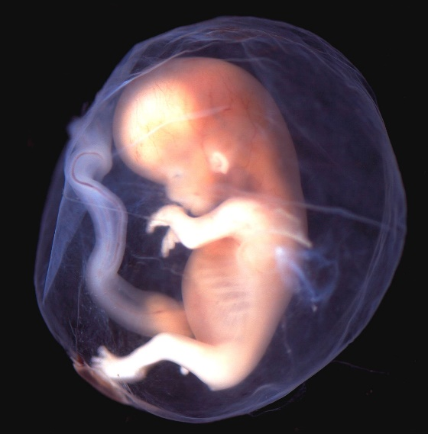
Verse 57
Argument 1 - Who created you?
The joining of a sperm to an egg
There is more to it than the mere action of humans
How does a human develop from one tiny embryo
Who fixes all the organs and develops the skeleton
Boy or girl?
Who gave the child hearing and sight?
If Allah can create you and give you life once, can he not the second time?

Slide 19
Verse 60
Argument 2 – Who gave you death?
No escape from death
You cannot choose when you die
Can you prolong your life if you want
Can you cause death to come to your early
Can you stop the soul from leaving?
If you cannot control your own death, who is the controller of all things?

Slide 20
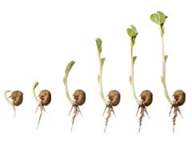
Verse 63
Argument 3 – Can you control the seeds growth?
Who caused the seed to germinate?
Who caused the seed to come out the ground?
Who allowed you to take benefit from this seed?
If you cannot control the seed growing, who is the controller of all things?

Slide 21
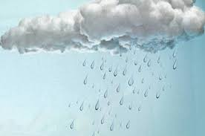
Verse 69
Argument 4 – Can you provide water?
Did you send the water from the clouds?
Did Allah send down the water?
Can you live without this water?
Allah can make the water bitter?
He can stop sending the water?
Can you give yourself the required water for life? Who controls the water?

Slide 22

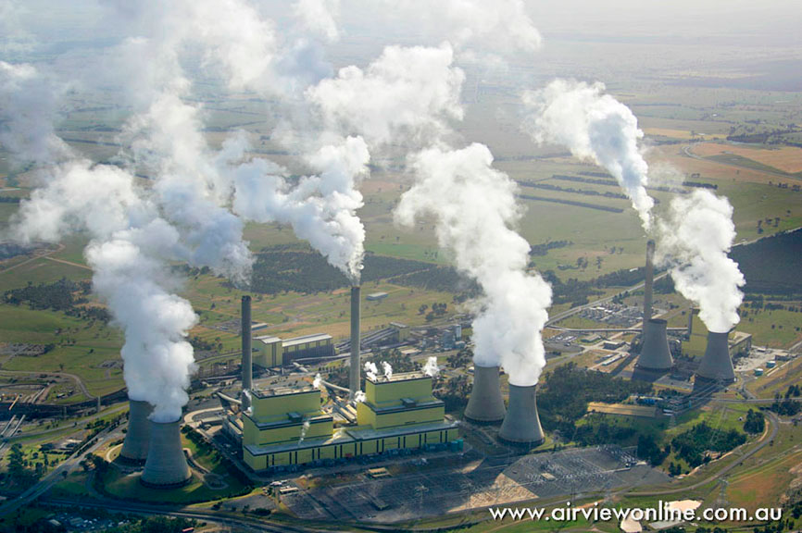
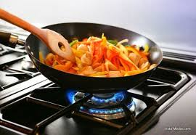
Verse 71
Argument 5 – Did you make the fire?
Did you make the timber grow?
No trade or Industry is possible without fire?
Even in modern day
Can you life without the fire, that you cannot create ?

Slide 23
Logical and rational conclusion is to be grateful to Allah by
= Proclaim the purity of Allah
Three things man in dependent
Food
Water
Fire

Slide 24
Section 6
Verse 75 - 96
Proof of Allah’s power – Through the Quran

Slide 25
Verse 77 – 79 – The preserved tablet is just touched by the purified one
If one has impurity on himself or is impure, he cannot touch the Quran
If there is a cover sown to the Quran the impure person cannot touch the Quran
It is from this verse that some scholars have decided that women in menstruation can not recite the words of the Quran
Can recite Quran without wudhu

Slide 26
Task
Research the four schools of fiqh, opinion with reasoning and evidences to their views of women in the state of menstruation touching or reciting the Quran

Slide 27
Verse 83 - 89
Mudhinoon – comes from idhaan which means to apply oil. When you apply oil to the body the muscles become relaxed. Will you take this message lightly?
Surah finishes by referring to the modes of death that will come to the 3 categories of people mentioned at the start of the surah.

