Slide 1
Surah Al –Hadid
The Iron
Madani – 29 verses

Slide 2
Virtues of Surah Al – Hadid
Irbad ibn Sariyah said that the Prophet Muhammad (May Allah’s peace and blessings be upon him) used to recite Al-Musabbihat before he went to sleep and said: “In them there is a verse more rewarding than a 1000 verses” (Abu Dawud, Tirmidhi and Nasai)
Al – Musabbihat refers to 5 surahs:
Al-Hadid
Al-Hashr
As-Saff
Jumu’ah
At - Taghabun

Slide 3
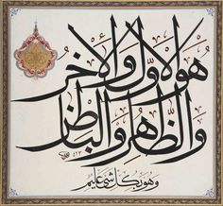
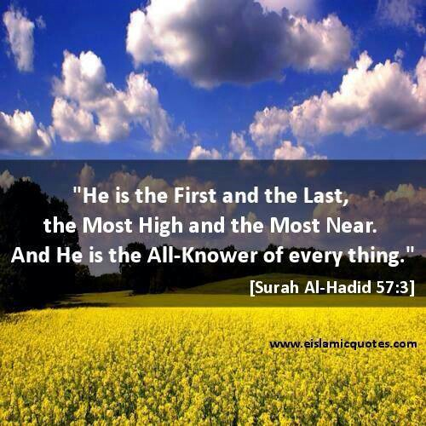
Ibn Kathir says the best verses is Verse 3 in Surah Al Hadid

Slide 4
Why are they called Al-Mussabihat?
These three Surah starts with praising Allah in the past perfect tense –
    - Sabaha – Purity has been proclaimed سَبَّحَ لِلَّهِ
Al-Hadid
Al-Hashr
As-Saff
These two surahs start with praising Allah in the imperfect tense –
يسَبِّحُ لِلَّه – Yusabbihu – Purity is proclaimed
Jumu’ah
At – Taghabun
The purity of Allah should always be declared, in the past, present and in the Future

Slide 5
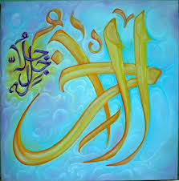
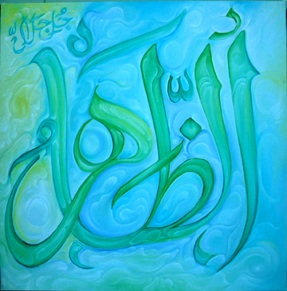
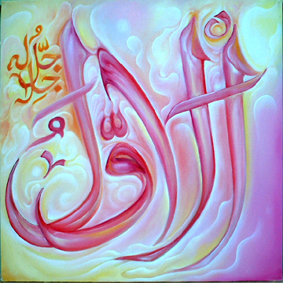
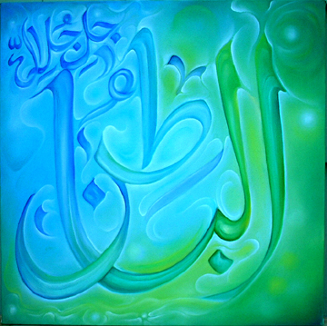
Verse 3
If Shaytaan whispers doubt into you about Allah and the religion of islam, you should recite this verse.
Al –Awal - The first – There was no one before Allah, he is the First cause of all existent things.
Al –Akhir – The last – He will exist after everything has perished
Az – Zahir – The manifest – His manifestation is superior to everything
Al- Batin – The Hidden – The accurate nature and essence of Allah’s being is hidden – it is beyond human perception

Slide 6
Verse 8 – He has taken your covenant
The Pre- eternity Covenant
Allah gathered all the souls (believers and disbelievers)
Allah asked them: ‘Am I not your Lord?’
All the souls replied: ‘Of course you are, We affirm!’
Or
This could refer to the pledge taken from the previous prophets and their followers to believe in the final Prophet Muhammad and to support him.

Slide 7

Verse 10 – While to Allah belongs the inheritance of the heavens and the earth?
What is inheritance?
The Assets of the deceased person is passed on to the living automatically, the deceased has no choice in this matter.
The ownership of the heavens and the earths belongs to Allah, so if you thinks this piece of land or something on the earth belongs to you it will ultimately return to Allah, no matter is you agree or disagree.

Slide 8
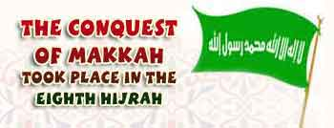
Verse 10 - Conquest of Makkah
Those who spent before the conquest of Makkah and fought in Allah’s way are not equal to others
Before Conquest of Makkah
Were small in number
Faced many hardships
Persecuted by the pagans
Put their own lives at stake by accepting Islam
Offered their lives and wealthy to support Islam
High level of Sincerity and sacrifice
After Conquest of Makkah
Islam spread tremendously
People accepted Islam in multitudes
No opposition or torture
No fear of defeat
Islam was recognised across the Arabian World

Slide 9
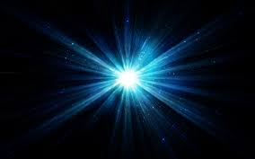
Verse 12 – The believers will be awarded a light
There will be total darkness
Each believers will receive a light to commensurate with his deeds
Some will have a light as large as a mountain and some as a date tree and some as big as the height of a man
The least amongst them will have a light as big as his index finger it will be lit at times and extinguished at times
This will happen just before you cross the bridge of siraat

Slide 10
Reasons for receiving the light from hadith
Those who go to the mosque in the darkness of the night
Those who take care of their 5 daily prayers
Whoever recites Surah Khaf on Fridays
Whoever recites a single verse from the Quran
Whoever sends Durood (salutations) to the Prophet Muhammad (May Allah’s peace and
blessings be upon him)
Stoning the Jamaraat at Mina in Hajj
Those who shave head to come out of Ihram
He whose hair turns grey, it will be a light
He who shoots one arrow in Allahs way
He who remembers Allah in the market place
He who removes the calamity of another muslim – a light that will brighten up the
whole world

Slide 11
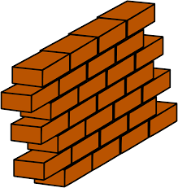

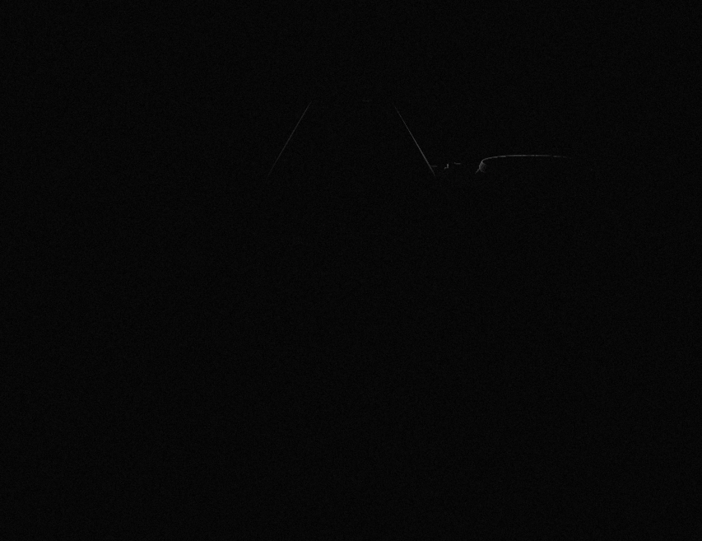
Verse 13
Believers
Divine Mercy
Hypocrites
Divine Punishment

Slide 12
There will be a door in the wall
For the disbelievers and believers to communicate
For all the believers to pass through and then sealed off permanently

Slide 13
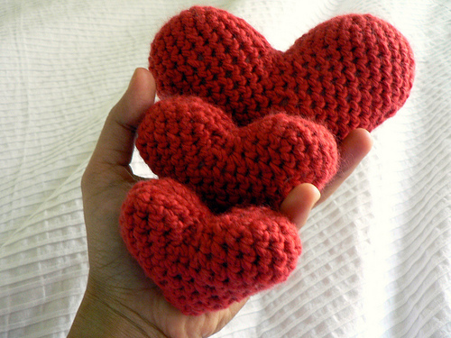
Verse 16 – Kushu – ul – qalb
For the heart to be softened
Reminder for the believers
After settling down in Medina the companions experienced socio – economic comfort and prosperity
This verse was revealed as a reminder
This verse was revealed 13yrs after revelation had started
The first thing that will be taken away from people is their humility/humbleness

Slide 14
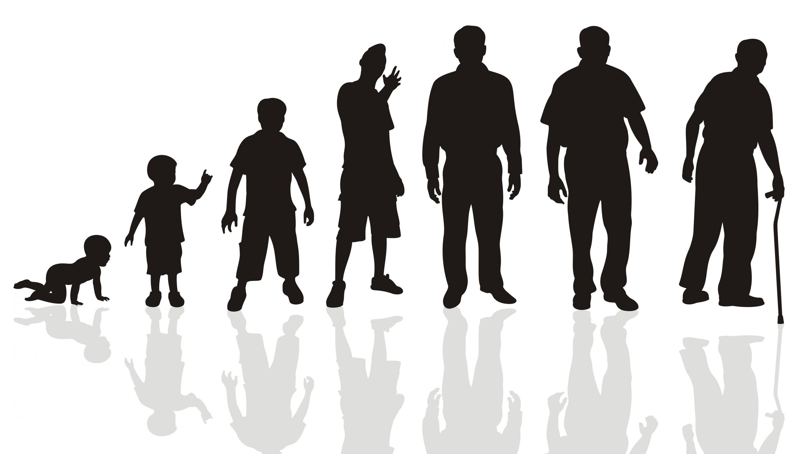
Verse 20
Realities of this world, listed in order on which they take place in ones lifetime:
Laib – Play that has no purpose (child)
Lahw – amusement (early teenager)
Zinah – show of beauty (Later teenager)
Tafakhur – Exchange of boastful claims (Young adult)
Takathur – Competition of increase in riches and children (Older adults)
At each phase of your life you feel satisfied with it and need nothing else. When that phase is over you realise the truth and how minor it and absurd it really was. Eg. Someone snatches a childs toy he is as hurt and upset a grown man loosing his wealth or property.

Slide 15
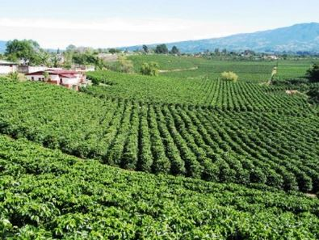
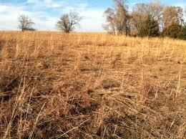
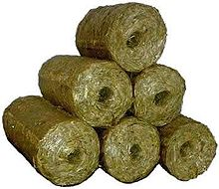
Parable
The vegetation attracts the farmers, but then it withers and goes yellow becoming straw
Literal sense of Kufar is farmers
This parable is an example of Mankind in this life, first they look young and handsome but when they get old, their beauty fades. This is the end of the life. The hereafter is surely coming….

Slide 16
Verse 21 – Compete each other
No one has guarantee that he will have good life, health and strength. Should not delay in doing good deeds for the future. You never know when death will come, or you will be unable to do a good deed.
Compete with each other in good deeds
Abu Huarairah reported that the Prophet Muhammad (May Allah’s peace and blessings be upon him) said: “No one will attain salvation by means of his actions only”

Slide 17
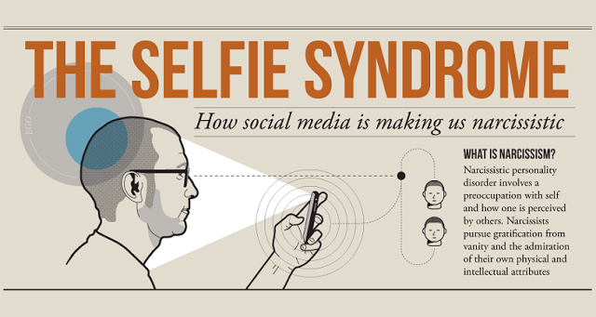
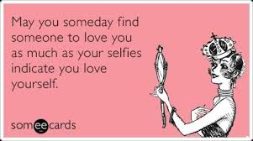
Verse 23 – Allah does not love any self-admirer and over proud
What is Narcism
https://www.youtube.com/watch?v=arJLy3hX1E8
Social media
How many likes does my video have?
How many followers do I have?
Do I want everyone to love me because I love myself?

Slide 18
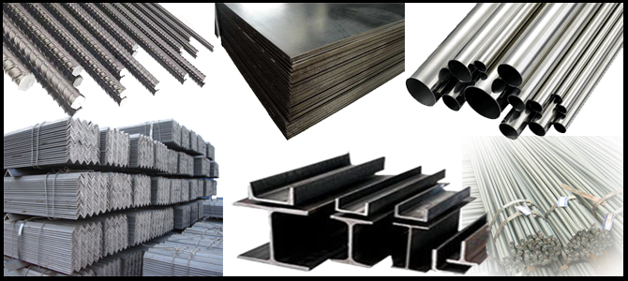

Verse 25 – Allah sent down The Book, The Balance and Iron
Iron serves two purposes:
It represents power and hold its opponents in great awe. It may compel the rebellious people to abide by the divine law
It hold great benefit for man – It is needed in the invention of every device, machine and apparatus.

Slide 19
Verse 27 – What is Rahbaniyyah -Monasticism?
Root word – Ruhban – The one who fears
Started from the time after Prophet Isa (AS)
Transgression become common
Kings and leaders publicly defied the laws of the Gospel
If scholars and righteous people stopped them they were put to death
They thought if they lived here their religion will be lost
They took it upon themselves to give up pleasures of this world, even the allowed ones
They avoided marriage, work, need to build houses and moved to the jungles, mountains and caves
Returned to nomadic lifestyle to be able to practise their religion freely
They did this all out of the fear of God

Slide 20
Christians introduced monasticism
If they promised to do a certain act of worship or promised to refrain from something, it became binding upon them to do so.
Its violation would be a sin
Monks
Started with the best of intentions but then deviated
This verse denounces monasticism – to turn lawful things into unlawful

Slide 21
Verse 28
Those who believed in Prophet Musa/Isa and Prophet Muhammad (May Allah’s peace and blessings be upon him) will receive double reward.

