Slide 1
How to be Mrs. Right
Marriage – Part 2
Ustadha Sumiyya Iqbal
Notes:
Replace these sample pictures with cute ones of your own. It’s easy to do: Select the sample picture and delete it. Now click the Insert Pictures icon inside the frame, and locate the picture you want display.

Slide 2
What do you want to achieve in a marriage?
Mentimeter

Slide 3
What do you want to achieve in a marriage?
Support
Love
Mercy
Passion
Intimacy
Respect
Companionship

Slide 4
What is the relationship between the husband and wife ?
هُنَّ لِبَاسٌ لَكُمْ وَأَنْتُمْ لِبَاسٌ لَهُنَّ ۗ
"They (your wives) are a garment for you and you too (husbands) are a garment for them." (Surah 2, Verse187)

Slide 5
How are spouses like garments?
Covers imperfections
Beautifies you
Protects you
Guards your modesty
Closeness

Slide 6
Love and Mercy
وَمِنْ آيَاتِهِ أَنْ خَلَقَ لَكُمْ مِنْ أَنْفُسِكُمْ أَزْوَاجًا لِتَسْكُنُوا إِلَيْهَا وَجَعَلَ بَيْنَكُمْ مَوَدَّةً وَرَحْمَةً ۚ إِنَّ فِي ذَٰلِكَ لَآيَاتٍ لِقَوْمٍ يَتَفَكَّرُونَ
"And one of His signs is that He has created for you, spouses from amongst yourselves so that you might take comfort in them and He has placed between you, love and mercy. In this there is surely evidence (of the truth) for the people who carefully think."
(Surah 30, Verse 21)

Slide 7
مَوَدَّةً Love وَرَحْمَةً Mercy

Slide 8
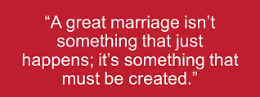
Marriage is hard work

Slide 9
What comes to you mind when you hear ‘WIFE’?
Mentimeter

Slide 10

Gratitude

Slide 11
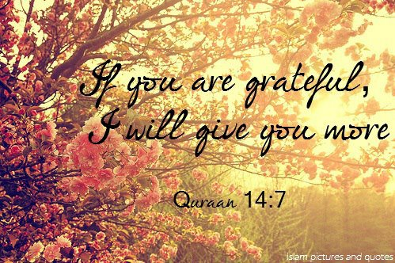
Allah’s rule of Gratitude
If you are grateful, Allah will give you more

Slide 12

Write down 10 things your husband done for you in the last 24 hours

Slide 13
A Warning?
The Prophet Muhammad (May Allah’s peace and blessings be upon him) said: “I seen the Hellfire, never seen anything like it before; and I saw the majority of its dwellers are women”.
They said why O Messenger of Allah? He said: “By their disbelief’ it was said: They disbelief in Allah?
He said: “They are ungrateful in their lives and benevolence. If you were good to her all your life and she has seen something (that displeases her) she said: I never saw any good from you ” (Bukhari and Muslim)

Slide 14

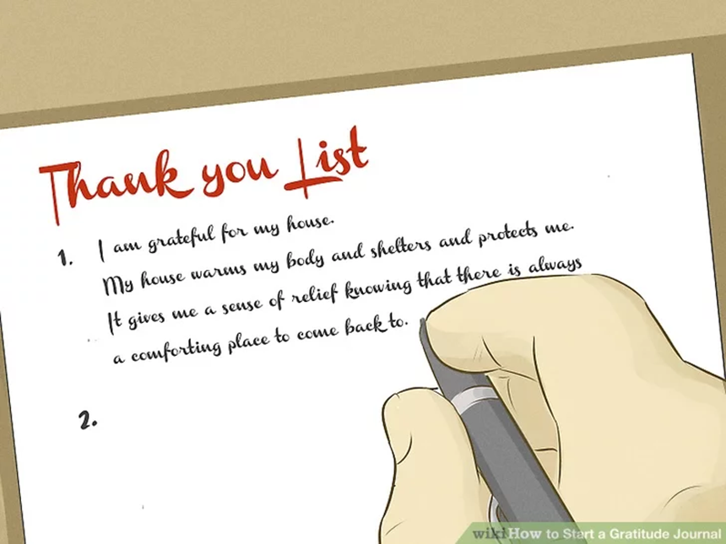
How can we show our appreciation?
So that we can get more?
Express gratitude
‘Thank you for doing the hoover
Do something extra nice in return
Gratitude journal

Slide 15

2. Give Give Give in your marriage and inshallah you will see the fruits

Slide 16

Marriage is like a plant

Slide 17
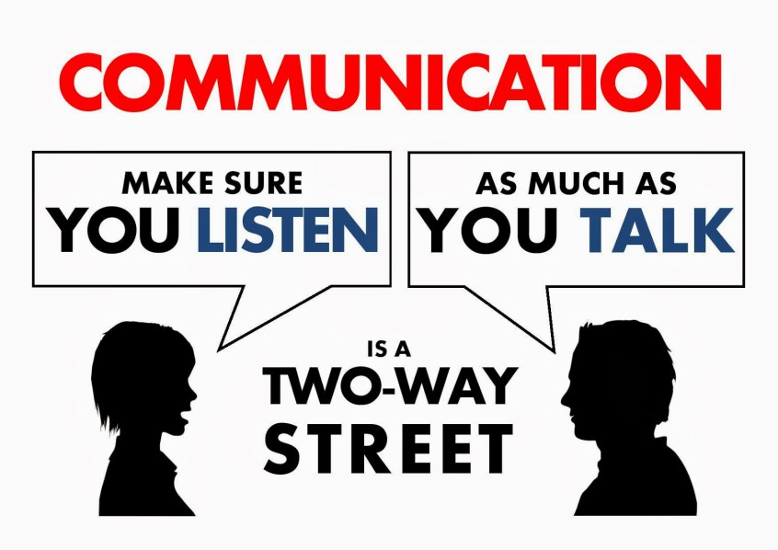
3. Effective communication

Slide 18
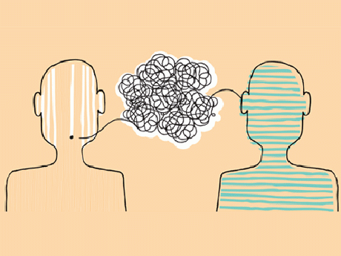
What does effective communication look like?
Share
Listen
Respond

Slide 19
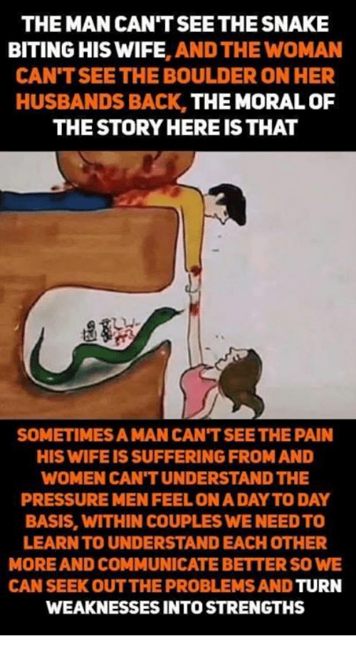
What do you see?

Slide 21
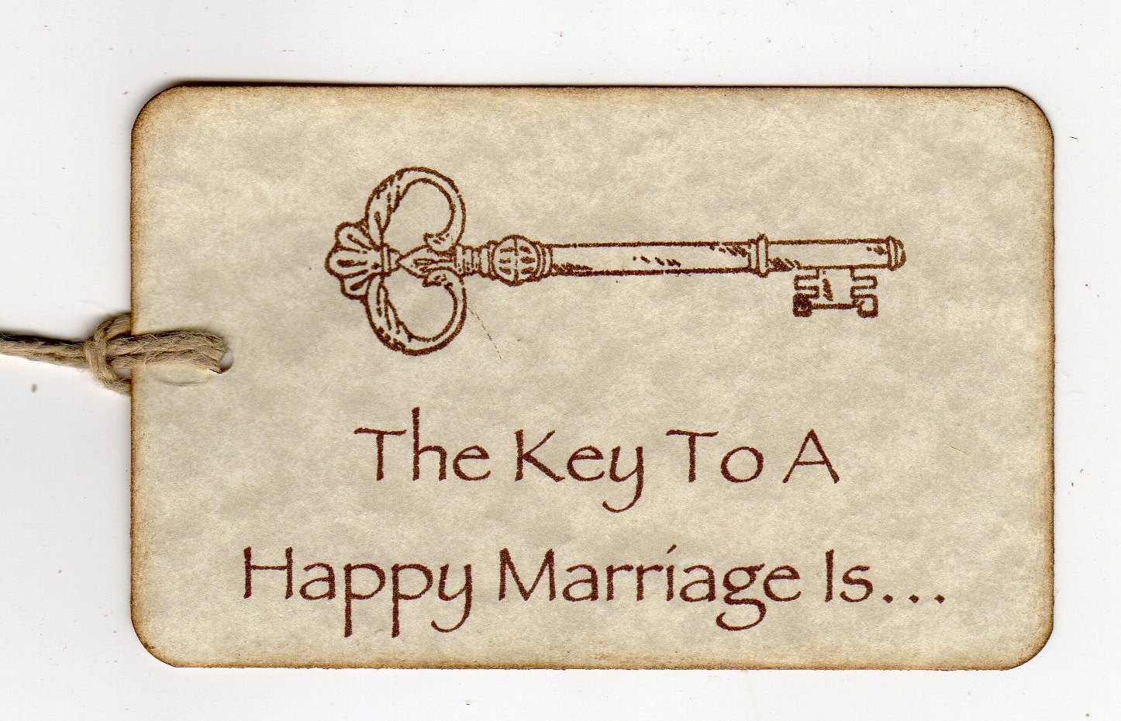

To follow the example of the best man and woman to ever come into this universe
Khadeeja (ra) + Prophet Muhammad

Slide 22
What did the Prophet Muhammad say about his beloved wife Khadeeja (ra)
‘She believed in me when no one else did; she accepted Islam when people rejected me; and she helped and comforted me when there was no one else to lend me a helping hand.”
“I have not yet found a better wife than her. She had faith in her when everyone, even members of my own family and tribe did not believe me and accepted that I was truly a Prophet and a Messenger of Allah. She converted to islam, spent all her wealth to help me spread islam. She was there when the entire world seemed to have turned against me and persecuted me. It is only through her that Allah blessed me with children. ”

Slide 23
What did Khadeeja (ra) say about Prophet Muhammad
“Do not worry,” she said, “for by Him who has dominion over Khadijah’s soul, I hope that you are the Prophet of this nation. Allah would never humiliate you, for you are good to your relatives, you are true to your word, you help those who are in need, you support the weak, you feed the guest and you answer the call of those who are in distress.”

Slide 24
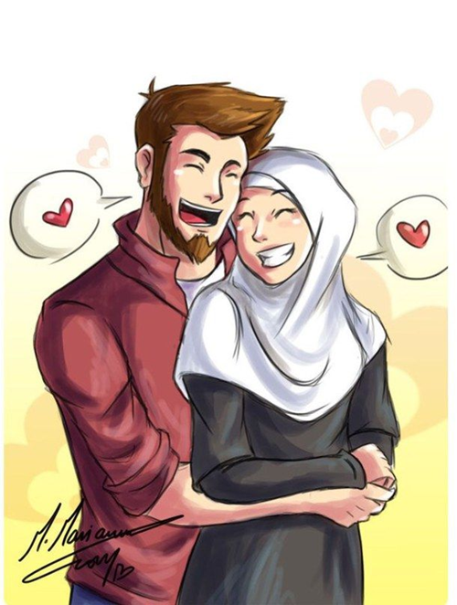
Scenarios -
What are the possible good/bad reactions the wife could have?
What impact will her actions have?
What would you advice the wife to do in this situation?
What character trait does this require?

Slide 25
Scenario 1
Sarah has had a fantastic day today. She has been offered a promotion at work for job she has been waiting for. She cant wait to share this news with her husband when he comes back from work, however, he walks in says Salaam and lies down on the sofa and pulls his phone out. He did not ask her how her day was!

Slide 26
Scenario 2
The kitchen sink has been faulty in Rima’s house for months and her husband has promised he will fix it multiple times. It has come to a point where if it is not fixed soon it will become permanently damaged. What should Rima do?

Slide 27
Scenario 3
Sarah and Umar have been really busy in their own individual routines and recently haven’t had much time to spend with each other. They both have long days, waking up early, engrossed in their respective tasks and sleeping late. Sarah realises that the spark is missing from their marriage. What can she do to help restore the spark and how can they make time for each other?

Slide 28
Scenario 4
Khadeeja does not agree on giving her daughter Nusaybah a device for more than 20mins a day and she has had her maximum time today on her tablet. Nusaybah’s dad, comes back from work and sees his daughter crying and gives her the tablet, despite Khadeeja saying that she has had her maximum time.

Slide 29
Scenario 5
Ahmed has told his wife that they won’t be able to go on holiday this year because he is saving for an investment. Maryam is really disappointed as she was really looking forward to it and had done her research on where she wanted to go and it’s their anniversary and he had promised her this holiday

Slide 30
Common Marriage problems
Money Problems
Issues with Children
Daily Stress
Busy Schedules
Poor Communication
Bad Habits

Slide 31
Parting advice – Be the best wife you can be
Obedience to the husband:
The Prophet Muhammad (May Allah’s peace and blessings be upon him) said: “If a women prayed her five obligatory prayers, fasted her month of Ramadan, protect her chastity, and was obedient to her husband; it will be said unto her enter Jannah through any of its gates you wish” (Ahmed and Al- Nisa’ai)
Pleasure of the husband:
The Messenger of Allah (blessings and peace of Allah be upon him) said: “Any women that died while her husband was pleased with her, will enter Jannah
(Ibn Majah)

